Slide 1
GRC Workshop
ASHG
22 Oct 2013

Slide 2
Outline
Reference Assembly Basics
GRC: Assembly management and dataflow
GRCh38
Accessing the assembly and data
http://genomereference.org
Notes:
During today’s workshop, we’ll cover the following four topics. We’ll pause between each section for Q&A, but you should also feel free to ask questions at any point.
The goals of today’s workshop are:
Equip you with an understanding of what the reference assembly is, so that you can use it and other assembly sequences critically and effectively in your research
Introduce you to the Genome Reference Consortium (GRC) and expose you to the processes they use to manage the reference assembly
Highlight new features and changes you can expect in the soon-to-be released updated assembly, GRCh38
Show you how you can access the assembly and data for your own use

Slide 3
Reference Assembly Basics
What is the
Reference Assembly?
Notes:
Section to inform users about what the assembly is, and to make sure they understand how it differs from the assembly of an individual genome.

Slide 4
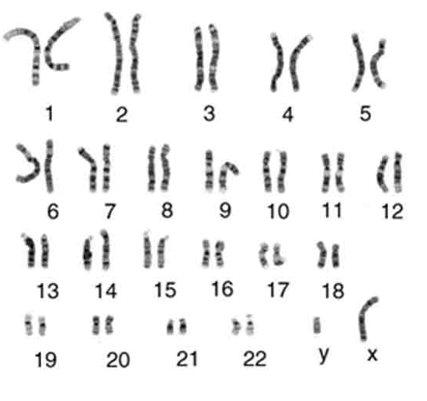
Notes:
This is what a real human genome looks like. A genome is the complete collection of DNA that encodes an organism’s hereditary information
Most healthy humans have a diploid genome, with one maternally and one paternally inherited copy of each chromosome.

Slide 5
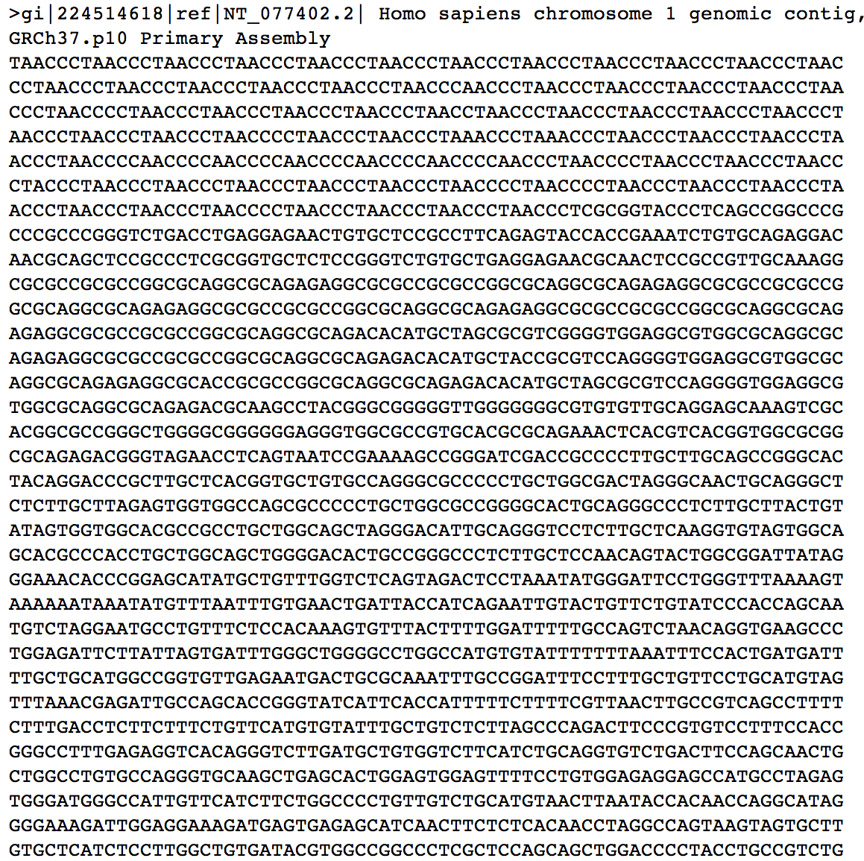

Notes:
While the genome is a collection of DNA molecules, we can represent the information encoded on each haploid chromosome as a linear sequence of bases. However, current sequencing technologies don’t allow us to sequence a chromosome in its entirety. Instead, we need to fragment the genome, sequence the fragments, and then re-assemble the sequences back into a representation of the DNA molecules. It’s for that reason we refer to collections of genomic sequences as assemblies.
No assembly process is perfect. As we’ll discuss today, it’s not always possible to get all the sequence or to place it unambiguously into a linear path.
Assembly is further complicated by the diploid nature of the genome, since there are actually two linear sequences for each chromosome. The similarity between an individual’s two haploid genomes depends both on the genomic region and their ancestry. A “phased” genome assembly is one in which techniques are used to distinguish the sequences from each molecule, so that the reconstructed linear sequence represents a single haplotype.

Slide 6
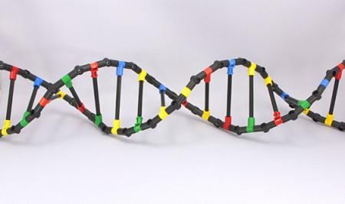
An assembly is a MODEL of the genome
Notes:
Thus, like the DNA model shown on this slide, an assembly is a model of the genome. The model may include chromosomes, unlocalized and unplaced sequences, and alternate loci used to represent an organism’s genome. The model provides us with information about the object hat it represents, but it is not the actual object.

Slide 7

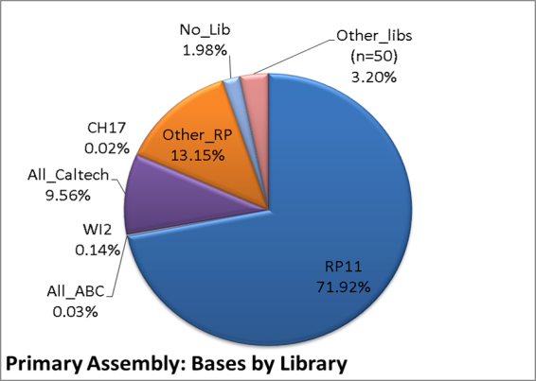
Notes:
The human reference genome assembly is not a haploid model of an individual genome. Rather, it is a model comprised of sequences from many anonymous individuals. This distinguishes the reference genome assembly from most other human assemblies being generated today.
As shown in this pie chart, about 70% of the sequence in the reference assembly come from a library constructed from single anonymous donor, known as RP11. Another 25% of the sequence come from 10 other libraries, while the remaining 5% represents sequence from 50 libraries.
Why were so many donors used?
One goal of the HGP was to produce a representation of the human pan-genome. At that time, there was significantly less understanding of human variation than we have today, and it was believed that a reference assembly consisting of linear chromosome models produced from multiple individuals, with differences described as sequence edits, would accomplish that goal. We’ll look at how well the reference assembly model accomplishes that goal later in the workshop.
Important things everyone should know about the reference assembly:
It is not a model of an individual genome, and the current reference model allows for the representation of more than two alleles at a given locus.
It provides the coordinate system upon which all annotations are made and the sequence against which variations are called.
It commonly serves as a guide for the assembly of other genomes that are now being sequenced.
The human reference genome assembly remains the highest quality mammalian genome sequence that has been produced. However, it’s not perfect, and errors in the reference assembly will influence the interpretation of analyses that are based upon it.
Let’s now take a look at factors that influence the production and quality of assemblies.

Slide 8
Reference Assembly Basics
Variables:
Assumptions
G= haploid genome length in bp
L= sequence read length in bp
N= number of reads sequenced
T= amount of overlap needed for detection in bp
C= Coverage (C=LN/G)
Reads are randomly distributed
Overlap between reads does not vary
Lander and Waterman
(1988) Genomics
Poisson distribution:
P(Y=y)=(λ^{y} * e^{–λ})/y!
y= number of events in an interval
λ = mean number of events in an interval
For sequence calculations, coverage can be viewed as λ
Using this equation, you can calculate the probability that a base has
been sequenced y number of times.
By manipulating this formula, you can estimate the numbers of gaps for any given level of coverage.
Notes:
The first thing is sequence: if you want to create a genome assembly, you need sequence. But how much physical sequencing do you need to do if you want to capture all the sequence in a genome?
This is the token bioinformatics slide in the workshop. Lander and Waterman developed a model several years ago that addresses this question. The assumptions and variables are as shown, and it turns out, assuming an random distribution of sequence, that we can use the Poisson distribution to calculate the likelihood that a particular base has been sequenced, given the average number of times a base has been sequenced.
You can then manipulate the formula to get an estimate of the number of gaps remaining in the assembled sequence.
Gap length= G*e^-C =total haploid genome length*%genome not sequenced
Number of Gaps =N*e^-C=number of reads sequenced*%genome not sequenced

Slide 9
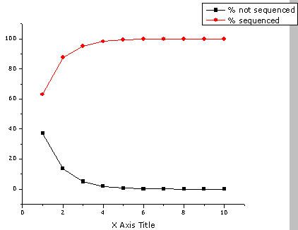
Reference Assembly Basics
Not sequenced
Sequenced
1X Coverage
37%
63%
5X Coverage
0.6%
99.4%
10X Coverage
0.005%
99.995%
Notes:
We can see how this works in this slide. Using Poisson, the likelihood that a base isn’t sequenced is simply e to the minus coverage.
Graph shows how the % of bases without sequence changes as a function of coverage (graph points sum to 100).
Note that from 5x-10x coverage, there’s not a huge increase in the number of sequenced bases.
Some food for thought: Mouse and human genomes are ~2-3 Gigabases (10^9). At 10x coverage, that’s about theoretically about 100-150,000 unsequenced bases per genome. These are simply bases that never get sequenced, irrespective of the sequencing technology used.

Slide 10
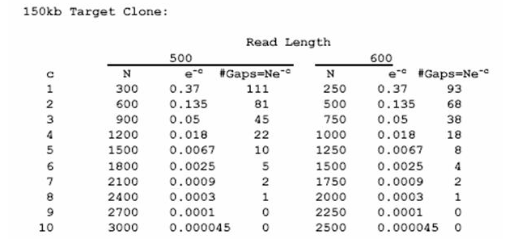
Reference Assembly Basics
2009 Sanger cost: shotgun sequence ~ $0.01/base
finished sequence ~ $0.03/base
This clone:
Shotgun=$1500
Finish=$3000
Notes:
This slide shows how you’d need to sequence an average sized BAC clone of 150 kb to 9-10x coverage to ensure you have no sequencing gaps. The reference genome is a clone based assembly, sequenced using Sanger technology. As illustrated, Sanger sequencing a clone to finished quality (meaning an error rate of no more than 1/10,000) is a costly endeavour.

Slide 11
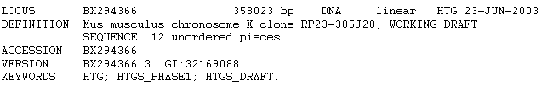
Reference Assembly Basics
Notes:
However, the model doesn’t always work, largely due to technical barriers .
These include:
library construction
cloning bias (when cloning is necessary for the sequencing technology)
sequencing limitations.
For example, this sequence has been sequenced to almost 15X coverage, which should give you complete coverage according to Poisson, but there is still no contiguous sequence and 11 gaps.
“Extra” missing sequence likely represents regions of the BAC that were difficult to clone.

Slide 12
Reference Assembly Basics
Bob Blakesley, NISC
Captured gap= no sequence, but a sub-clone spans the gap
Uncaptured gap= no sequence, no sub-clone spanning gap
Notes:
Experiment performed by Bob Blakesley at NISC. Shotgun sequenced BAC clones from different organisms to same coverage, assembled the sequences and then looked to see how many gaps remained.
Take home: The number of gaps per BAC varies from organism to organism.
This indicates that there is a biological (and thus genome composition) issue contributing to the ability to sequence an organism.
TAKE HOME POINT:
EVEN IF YOU SEQUENCE TO AN “APPROPRIATE” COVERAGE, YOU’RE STILL LIKELY TO HAVE MISSING SEQUENCE IN YOUR ASSEMBLY.

Slide 13
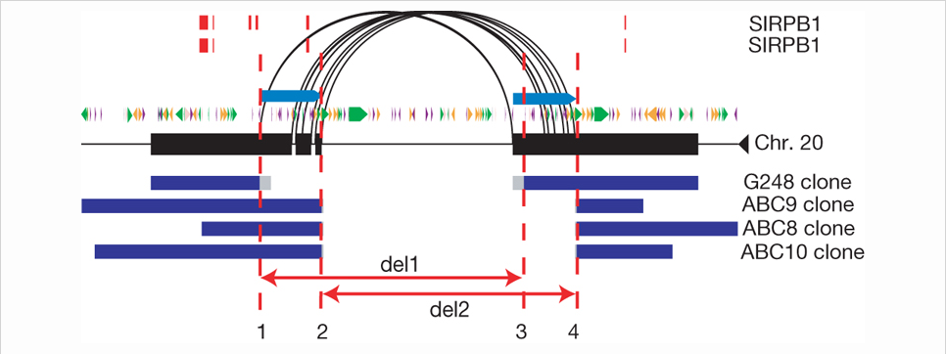
Reference Assembly Basics
Biology
Repetitive sequence
(interspersed repeats, segmental duplications)
Variation
(regions of high diversity, structural variation)
Kidd et al., 2008
Notes:
Biology, particularly repetitive sequence and variation, can also complicate genome assembly.
When dealing with repetitive sequence:
You can end up with a greater than anticipated trace depth in the contigs you construct.
When scaffolding contigs, you end up with too many or conflicting pairing relationships.
This often leads to repetitive sequences being left out of the assembly completely, collapsed or tossed into a bucket of unassembled sequence known as chr. Un or random.
These problems are more acute in WGS assemblies than clone-based assemblies, particularly those generated via short read technologies, b/c shorter reads are more likely to be comprised wholly of repeat, without any unique sequence to help distinguish different repeat copies from one another.
Likewise, assembling sequences from structurally variant regions can also be problematic b/c it can be difficult to sort out the two different haplotypes present in a genome from one another. This may result in incorrectly joined sequences, or if the variation is too great, gaps in the assembly.
Repetitive sequence and variation often occur in combination with one another, as illustrated in this figure from a paper from Evan Eichler’s lab in which end sequences from various fosmid libraries were mapped to the reference assembly to identify structully variant regions. These alignments uncovered two deletion variants in the SIRPB1 locus on chr. 20 (red: exons). The deletions (red arrows) are likely mediated by a segmental duplication (light blue arrows) located in a region full of interspersed repeats (green: LTR, purple: STR, orange: transposon, black: alignments).

Slide 14
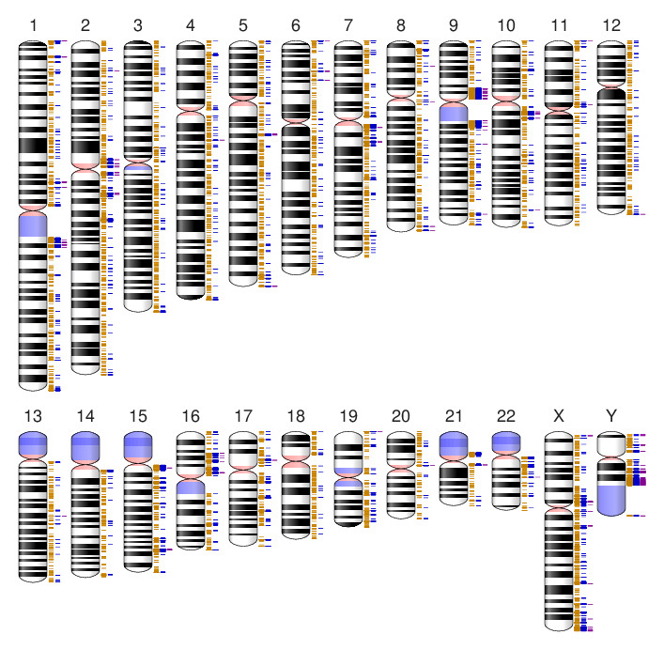

Reference Assembly Basics
Eugene Yaschenko, NCBI
Notes:
This slide gives you an idea of how much repetitive sequence exists in the human genome. An NCBI analysis looked at the distance you must extend from any base in the GRCh37 reference assembly in order to define a unique -kmer. Not only are there a large number of regions in the assembly where extensions of 500 bp don’t define a unique k-mer (yellow), there are several regions where extending as far as 10 kb still does not result in the production of a unique sequence (purple).
Given that many sequencing technologies today produce reads <500 bp, this analysis highlights the challenges in read assembly and the reason that many such assemblies have relatively low scaffold N50s.

Slide 15
Reference Assembly Basics
Human- PANTHER classifications (biological process)
5
60
4
40
3
2
Select regulatory molecule
20
Nucleic acid binding
Other transcription factor
G-protein modulator
1
Ribosomal protein
Extracellular matrix
Unclassified
Hydrolase
Protein kinase
Kinase
0
0
-1
Chemokine
Apolipoprotein
Oxygenase
Structural protein
Oxidoreductase
Cytokine receptor
Cysteine protease
Transcription factor
Intermediate filament
Signaling molecule
20
Miscellaneous function
-2
Other cytokine receptor
Defense/immunity protein
Cell adhesion molecule
Cysteine protease inhibitor
Other cell adhesion molecule
Zinc finger transcription factor
Tumor necrosis factor receptor
KRAB box transcription factor
CAM family adhesion molecule
-3
Immunoglobulin receptor family member
Major histocompatibility complex antigen
40
-4
-5
60
Enrichment
Observed
Evan Eichler, University of Washington
Expected
Notes:
I also want to emphasize that the sequences contained within duplications are not junk. In fact, in humans, these regions are slightly enriched for transcript sequences, many of which encode protein coding genes, as illustrated on this slide.
In this experiment from Evan Eichler, PANTHER was used to classify genes into different families. Based on number of genes in a family, you can calculate the number of family members you would expect to find in a sequence of a given length. This analysis found that many gene families have enhanced representation in segmentally duplicated regions. Mouse segmental duplications also contain genes.
PANTHER: Protein Analysis Through Evolutionary Relationships; classifies genes by their function (evidence and evolutionary rltnshps).

Slide 16
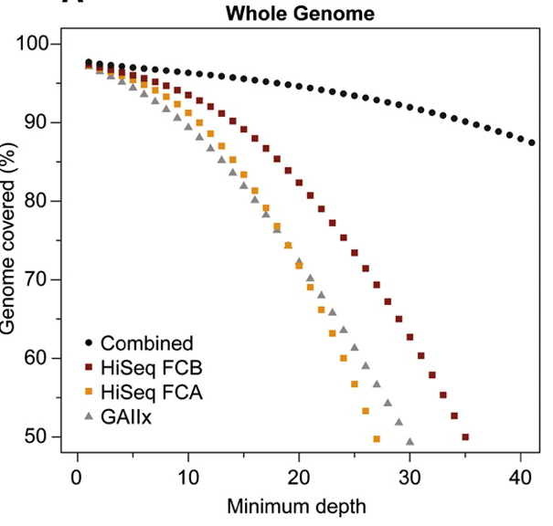
Technology
Read length
long reads vs. short reads
Mate lengths
distribution of insert sizes
Read accuracy
error model for your technology
Ajay et al., 2011
Read depth
coverage at each base
Genome distribution
reads covering entire genome equally
Notes:
Sequencing technologies can also affect the quality of an assembly. Technologies vary with respect to:
Read length
Mate pair lengths
Read accuracy
Read depth
Genome distribution
This figure plots the breadth vs. depth of coverage achieved for various Illumina technologies used to sequence a human sample. The x-axis represents the depth of coverage for high quality alignable bases (minimum number of high-quality bases (>Q20) from high-quality alignments (>MapQ30)), and the y-axis represents the proportion of genome covered at that depth. Can see that even at 30x depth of coverage, only about 50% of the genome is actually represented.
Take-home: random generation of sequencing reads does not always guarantee that every region in the genome will be uniformly represented, and the sequencing technology you use will affect the production and characteristics of your assembly.

Slide 17

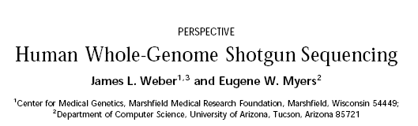
Reference Assembly Basics
Genome Research, May, 1997
Notes:
An assembly will also reflect the methodology used to produce it.
Back in 1997, two different approaches were debated for assembly of the human reference genome: Whole Genome Shotgun and clone (or tiling path) based.
While there are pros and cons to both methodologies, the HGP adopted a clone-based approach for the reference assembly. Thus, the reference differs from most individual genome assemblies produced today, which are WGS. In the next couple of slides we’ll look at some of the differences in the two approaches.

Slide 18
Reference Assembly Basics
WGS: Sanger Reads
Restrict and make libraries
2, 4, 8, 10, 40, 150 kb
End-sequence all
clones and retain
pairing information
“mate-pairs”
Each end sequence
is referred to as
a read
Find sequence overlaps
tails
WGS contig
Scaffold
Notes:
WGSA- in this approach, there is no upfront genome mapping. The entire genome is assembled de novo.
1. The entire genome is fragmented into pieces of varying size and then cloned into the appropriate vectors.
2. (Clones) from these libraries are end sequenced.
3. An initial phase that looks for sequence overlaps is used to generate contigs (these should have no Ns).
4. A second phase uses the pairing relationship of the reads to order and orient the contigs into scaffolds.
Using libraries of different insert sizes improves assembly as the smaller sizes help with the contig step and the larger sizes improve the scaffolding step.

Slide 19
Reference Assembly Basics
Genome Vocabulary
Contig: a sequence constructed from smaller, overlapping sequences, which contains no gaps.
Typically built from reads, but also from sequences in GenBank/EMBL/DDBJ
Scaffold: a sequence constructed from smaller sequences, which may contain gaps.
Typically built from sequences in GenBank/EMBL/DDBJ
Notes:
This brings me to some important assembly vocabulary terms.

Slide 20
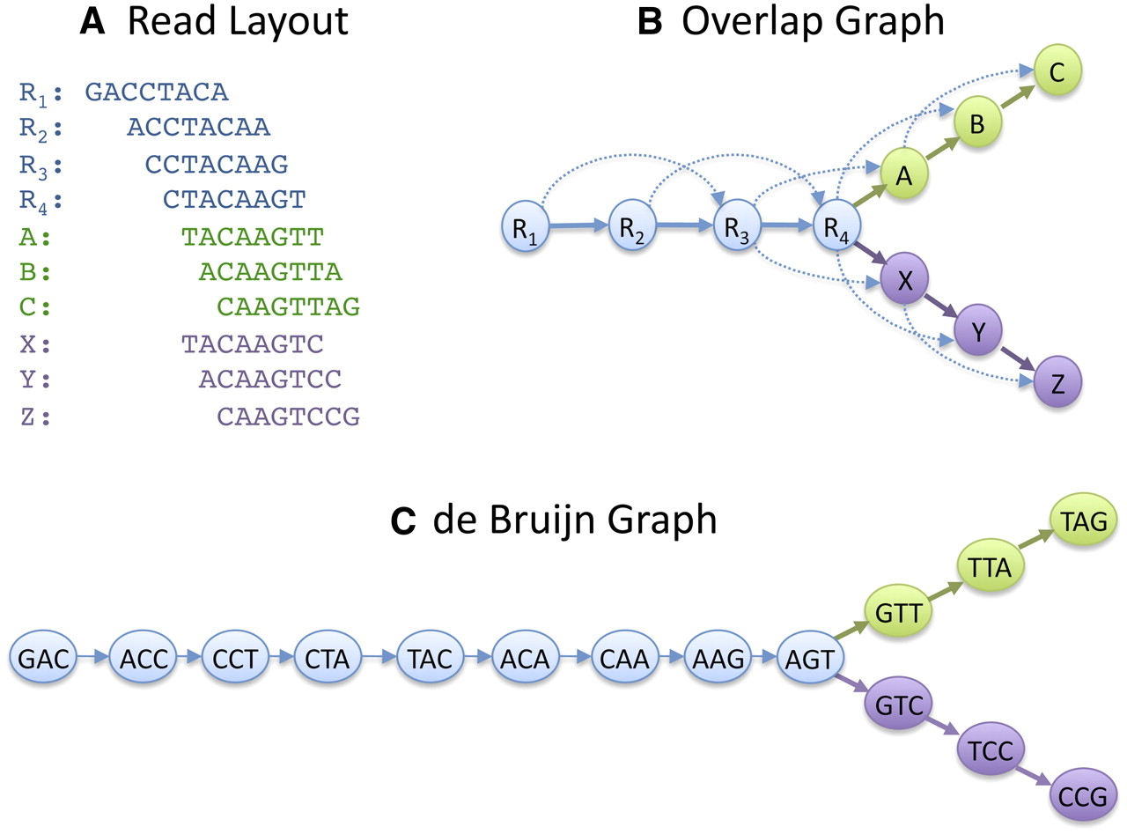
Reference Assembly Basics
Schatz et al, 2010
Notes:
With the advent of next generation sequencing technologies, there have been changes in the way WGS reads are assembled. These are summarized on this figure from Schatz et al.
Historically, overlap graphs (B) were generated from a set of overlapping Sanger reads (A). Each read is a node in the graph, and weighted edges connect overlapping reads. Alignment discrepancies lead to forks in the graph. Importantly, the relationships of the reads to one another are preserved in these graphs (as illustrated by the dashed arrows).
In recent years, de Bruijn graphs have become more widely used to assemble the shorter reads produced via NGS technologies.
In contrast to the overlap graph, the location of the reads aren’t known in a de Bruijn graph. Instead, in this approach, the reads are decomposed into k-mers that in turn become the nodes of the graph. A directed edge between nodes indicates that the k-mers on those nodes occur consecutively in one or more reads.
While de Bruijn graphs generally outperform overlap graphs in the assembly of short reads, it’s important to realize that b/c the k-mers nodes are divorced from the actual reads, the graph can produce paths that are not supported underlying by reads.
Thus, different assembly methods can produce different assemblies from the same set of reads.

Slide 21
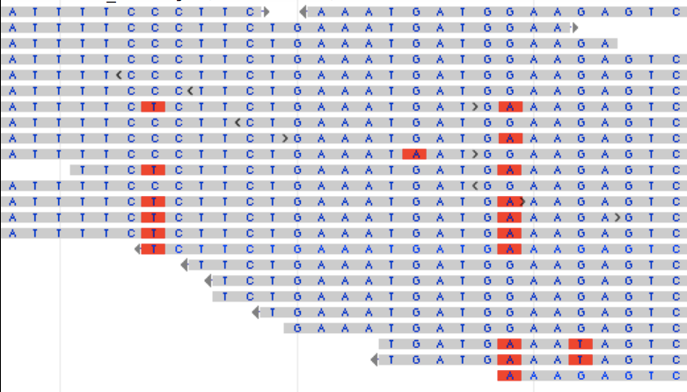
Reference Assembly Basics
A T T T T C C C T T C T G A A A T G A T G A A A G A G T C
Notes:
One consequence of the WGS assembly approach is that haplotype blocks tend to be smaller unless you have good phasing. This is illustrated here, where this set of reads from a individual diploid genome shows evidence of LD for two bases. However, the consensus sequence mixes the two haplotypes and reduces the block size.

Slide 22
Reference Assembly Basics
Clone based assemblies
BAC insert
BAC vector
Shotgun sequence
deeper sequence
coverage rarely
resolves all gaps
Fold sequence
Assemble
Gaps
GAPS
“finishers” go in to manually
fill the gaps, often by PCR
Notes:
The alternative to a WGS assembly is a clone-based assembly. This is the technique used to generate the human reference genome assembly.
In this case, the genome is fragmented (sheared, or by restriction digest) into relatively large fragments and cloned into a vector (like a BAC).
Clones are isolated and their order is determined w.r.t. one another using some sort of mapping technology (typically fingerprint mapping in conjunction with markers associated with linkage or RH maps).
As a minimal path is developed, individual clones are shotgun sequenced and assembled.
It’s been shown that gaps remaining after the shotgun sequencing and assembly of a clone are rarely resolved by deeper sequence coverage. Instead, finishers go in manually to fill the gaps, often by PCR.
Overlap between individual clones is determined and a consensus sequence is generated based on the overlap of adjacent clones.
NOTE: This approach reduces the de novo assembly problem from a global problem to a local problem.

Slide 23
Reference Assembly Basics
Ideally…
A
B
A
C
F
B
G
D
H
C
E
D
K
F
L
G
H
A
F
I
G
B
J
H
C
K
K
D
L
L
M
O
O
N
N
(flip)
N
O
Non-sequence based Map
Notes:
Ideally, the sequences generated will be concordant with the non-sequence based map that was used to guide the assembly.

Slide 24
Reference Assembly Basics
More like…
A
A
B
C
C
C
B
D
D
?
Y
Z
E
Y
F
X
A
A
G
W
B
B
H
H
H
H
I
J
I
I
J
J
J
V
K
L
L
M
L
M
M
M
N
N
N
O
N
O
O
O
Notes:
However, things are rarely this simple. There may be multiple non-sequence based maps that have discrepancies in marker order and/or include different markers. Reconciling the maps to one another and to the assembled sequence generally requires additional mapping and sometimes additional sequencing.

Slide 25
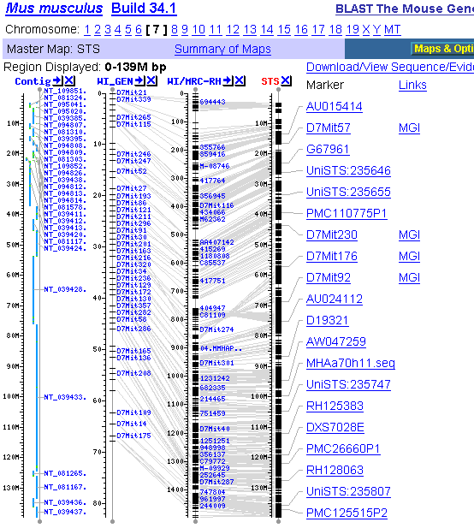
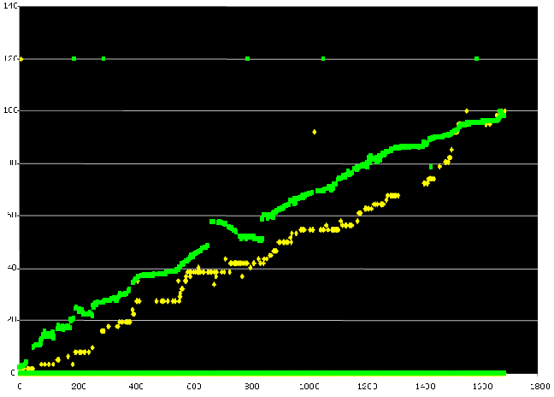
Sequence vs. Non-sequence based maps
WI Genetic
WI/MRC RH
Mmu7
Notes:
A real-life example of such a discrepancy is shown in this graph, where two different non-sequence maps for mouse chromosome 7 are plotted against the assembled chromosome sequence (Build 34). The genetic map (yellow) largely matches the sequence, but the radiation hybrid map (green) shows an inversion. This inversion may reflect recombination suppression.
Take-home message: the assembly method used will influence the outcome of the assembly and is also a source of bias and error.
.

Slide 26
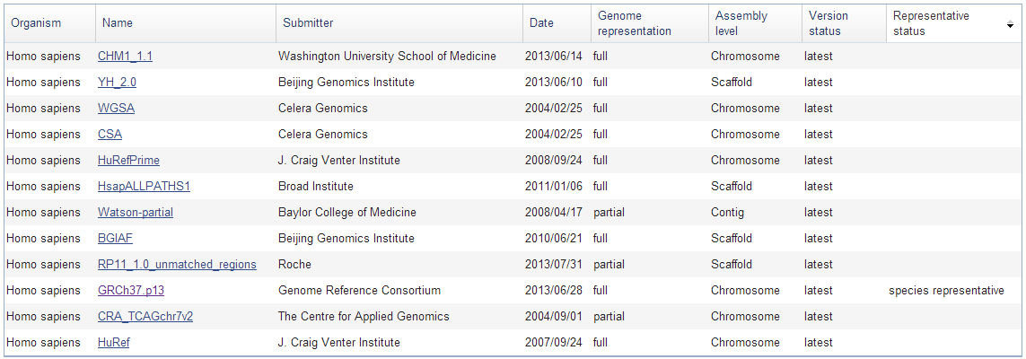
Reference Assembly Basics
Human assemblies available in the NCBI assembly database
http://www.ncbi.nlm.nih.gov/assembly
Notes:
Now that you know something about how assemblies are generated, let’s look at some real-life examples. This slide shows a listing of the current human genome assemblies in the NCBI Assembly database. How can you distinguish them and determine whether they are suitable for use in your analyses? The first distinctions are basic:
Genome representation (full vs. partial)
Assembly level (chromosome vs. scaffold vs. contig)

Slide 27
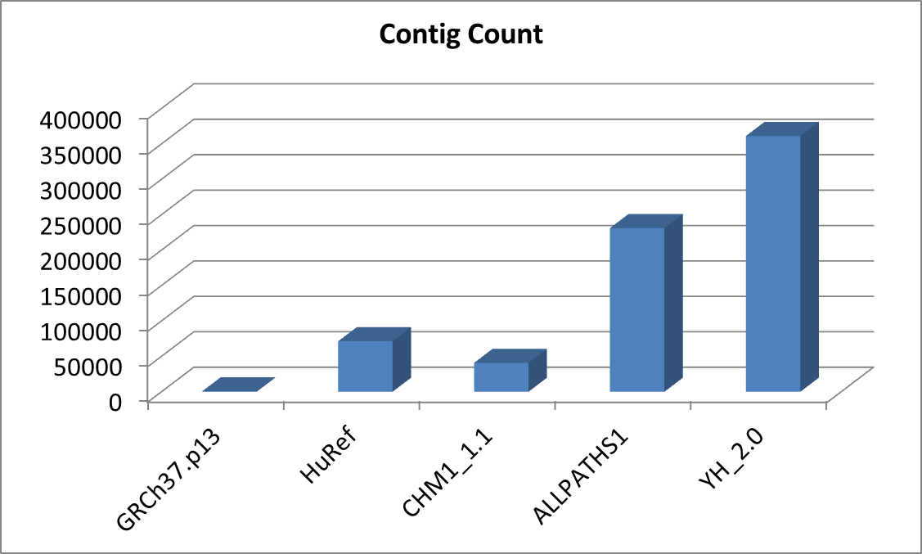
Reference Assembly Basics
Notes:
Next, you may want to examine the contig count of the assembly. This is a metric for how fragmented the assembly is. The lower the contig count, the less fragmented the assembly.
This slide plots the contig count for 5 different human assemblies:
Reference has <1000 contigs.
HuRef, a WGS assembly generated from Sanger reads, has about 70,000.
Comparison to Reference demonstrates the difference that assembly methodology can have (with same seq technology)
ALLPATHS and YH are do novo WGS assemblies of next gen sequence. They both are only assembled to the scaffold level and do not have any assembled chromosomes.
These are the most highly fragmented
Comparison to HuRef (also WGS method) illustrates how sequencing technology can affect an assembly.
CHM1_1.1, the newest assembly shown in this figure, is a reference-guided assembly comprised of both next-gen WGS reads and clone sequence.
Slightly less fragmented than HuRef, this lower contig count reflects both the use of the reference guided approach and the influence of the clones in the assembly.

Slide 28
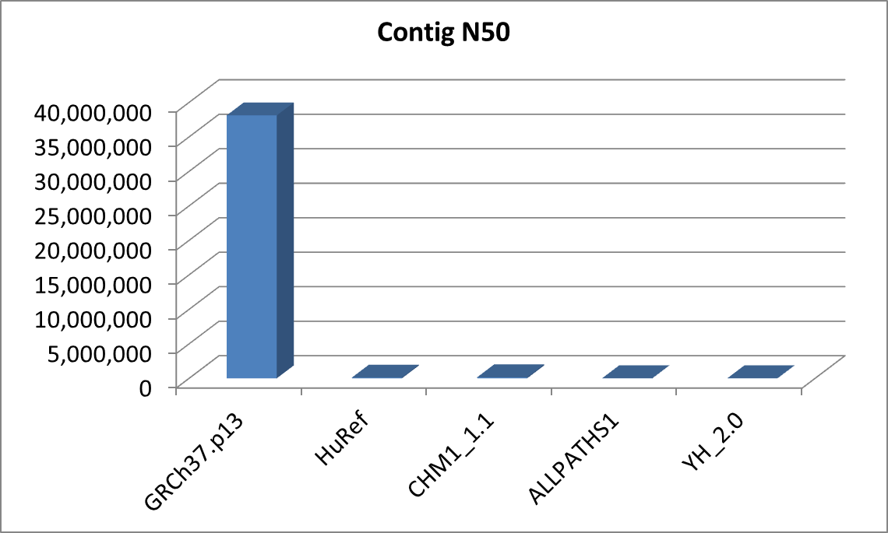
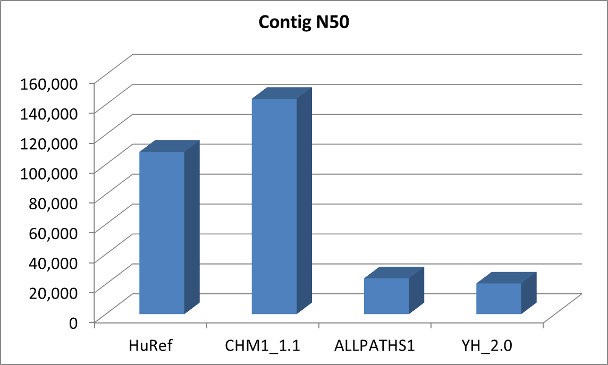
Reference Assembly Basics
N50:
Measure of continuity.
Half of the contigs in the
assembly are this length or
greater.
Notes:
Another metric for assessing assembly quality is Contig N50, which is a measure of continuity. The value for contig N50 means that 50% of the contigs in the assembly are that length or longer.
This graph shows the Contig N50s for the same assemblies shown on the previous slide. The contig N50 for the reference assembly dwarves the others, due to this being an entirely clone-based assembly.
Looking just at the WGS assemblies, we can see that:
The Sanger read-based HuRef and reference-guided WGS/clone hybrid CHM1 assemblies have the larger Contig N50s
The de novo short read WGS assemblies have the shorter N50s.

Slide 29
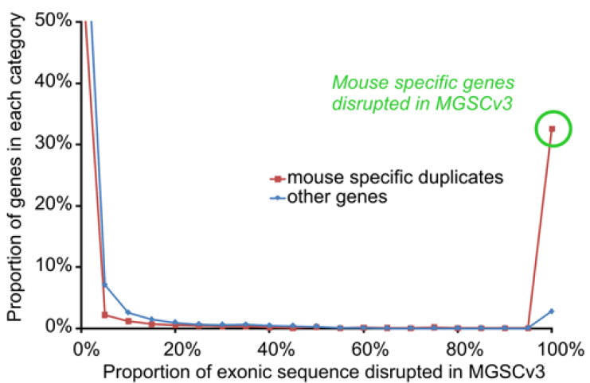
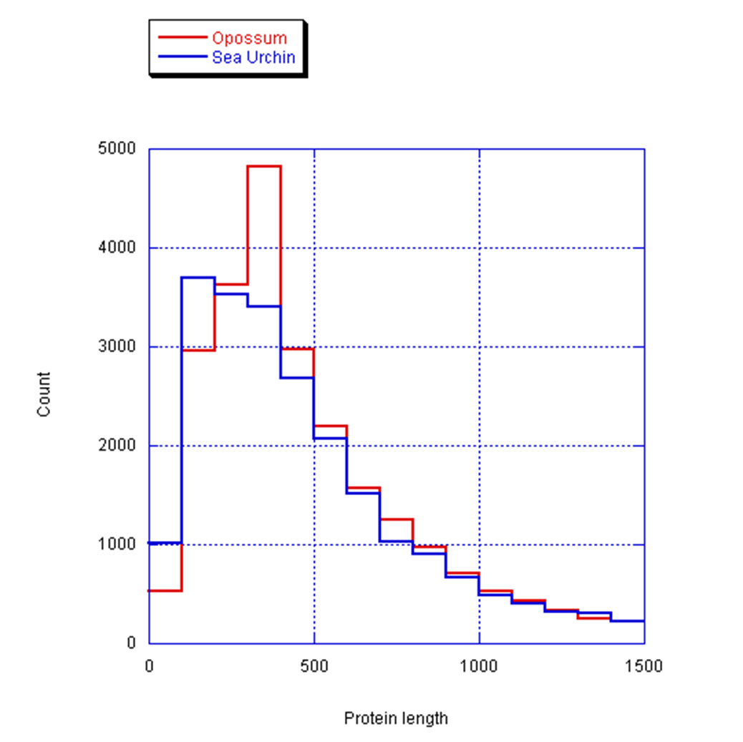
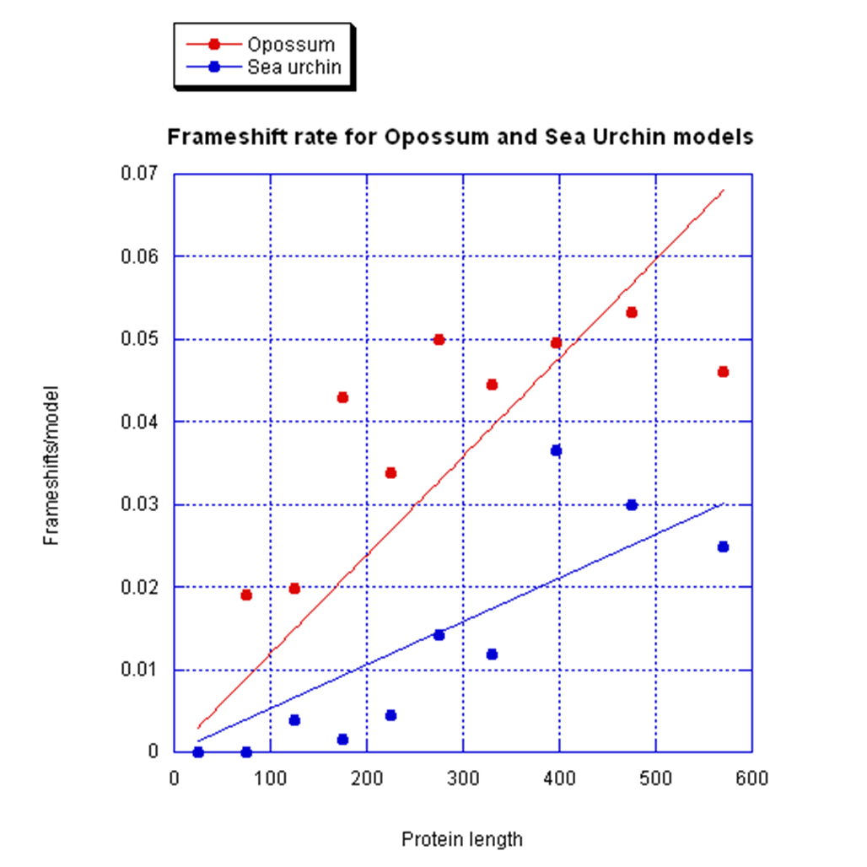
Reference Assembly Basics
Fragmented genomes tend to have more partial models
Fragmented genomes have fewer frameshifts
Alexander Souvorov, NCBI
Notes:
One important practical consequence of N50 has to do with gene annotation. If the average gene length for an organism is greater than the N50, there are likely to be many fragmented genes in the assembly. This point is illustrated in this graph that compares protein lengths in the sea urchin genome, which is highly fragmented, to the opossum genome, which is much less fragmented. There are many more short proteins in the sea urchin genome.
However, if scaffolding in an assembly is too aggressive, it can also have detrimental effects on gene representation. This is shown in the second graph, which demonstrates that the gene models in the less fragmented opossum assembly have more frameshifts than gene models in the highly fragmented sea urchin assembly. This trade-off between length and error illustrates the effects of assembly on annotation.
Individual base quality is another assembly feature affecting gene annotation. This is illustrated by this graph showing the disproportionate percentage of lineage-specific genes that were disrupted in the draft mouse assembly. In this case, improving base quality via finishing of the assembly improved this annotation.
All together, these slides illustrate that you need understand how various factors described here will affect the characteristics of an assembly, so you can make informed decisions when generating or using existing assemblies.

Slide 30
Outline
Reference Assembly Basics
GRC: Assembly management and dataflow
GRCh38
Accessing the assembly and data
http://genomereference.org

Slide 31
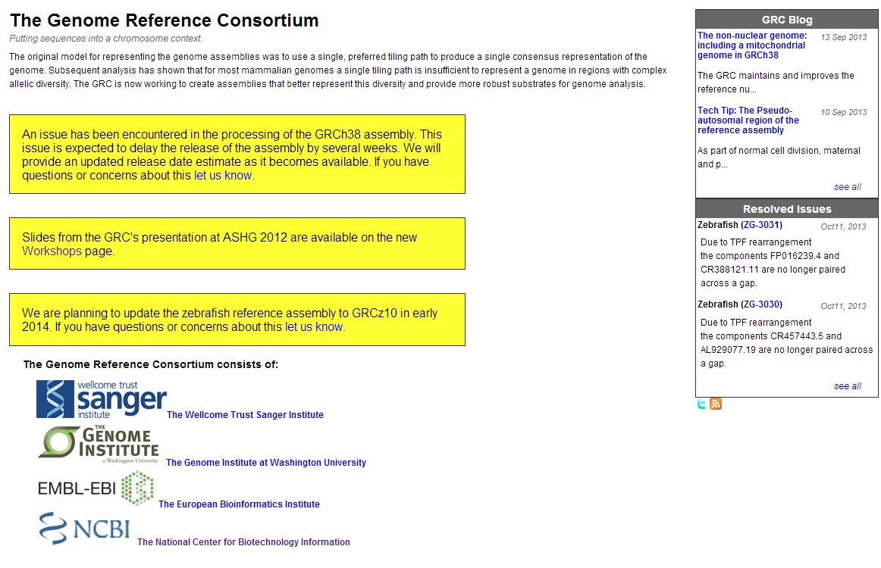



http://genomereference.org
Notes:
Now that we’ve covered some assembly basics, let’s talk about what’s happening with the human reference genome assembly.
At the conclusion of the HGP, the Genome Reference Consortium (GRC) was established to manage future improvements to this important resource. The GRC subsequently became responsible for the management of the mouse and zebrafish reference genome assemblies. The GRC is composed of 4 institutions and is committed to improving and enhancing genome assemblies.
Focus on rebranding the GRC: not just janitorial services. Its more about adding value to the reference genome.

Slide 32
GRC Assembly Management
Human Genome Project (HGP)
Distributed data
Old Assembly Model
Genome not in INSDC Database
Notes:
The management of the human reference assembly by the GRC differs from its management by the HGP in three major ways.
Data distribution
Assembly model
Use of public sequence databases
We’ll now take a look a how each of these has changed.

Slide 33
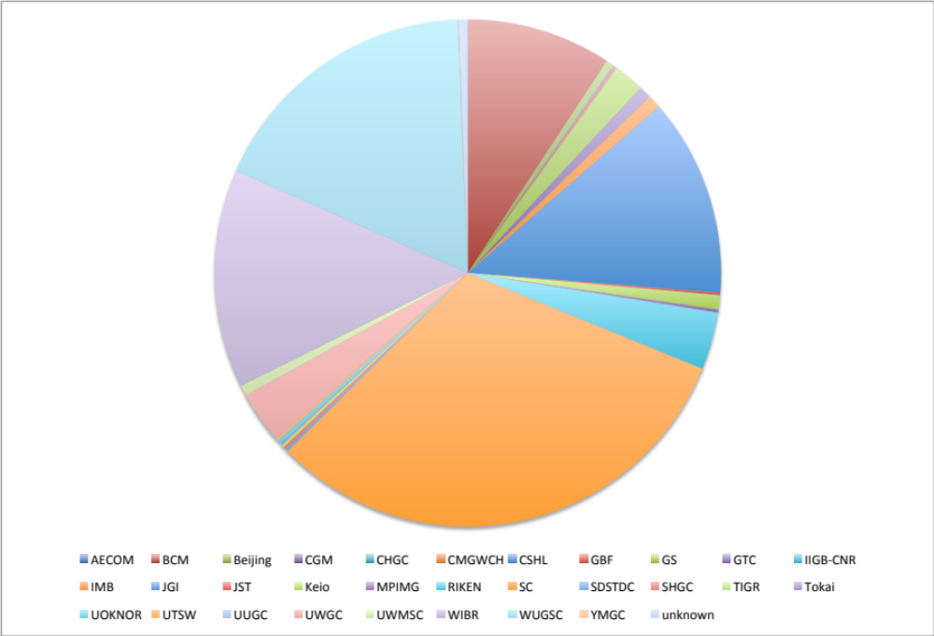
GRC Assembly Management
Notes:
This slide emphasizes distributed nature of HGP and shows the bases contributed to reference assembly by sequencing center.
While this distributed approach was key to the timely completion of the project, it also resulted in a lack of standardization in assembly protocols.

Slide 34
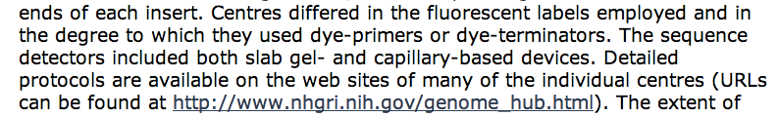
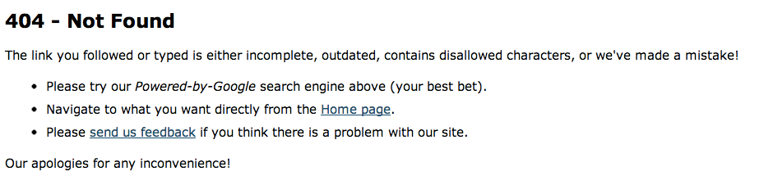
GRC Assembly Management
Notes:
This is illustrated in this excerpt describing the sequencing protocols used by the HGP. Unfortunately, much of this original information has been lost or is no longer transparent to users, as maintenance of HGP websites ceased upon the completion of the project.
.

Slide 35

GRC Assembly Management
Distributed data
Centralized Data
Old Assembly Model
Genome not in INSDC Database
Notes:
The first difference in reference assembly management since the GRC assumed responsibility for it is that assembly data and procedures have now been centralized and standardized.

Slide 36
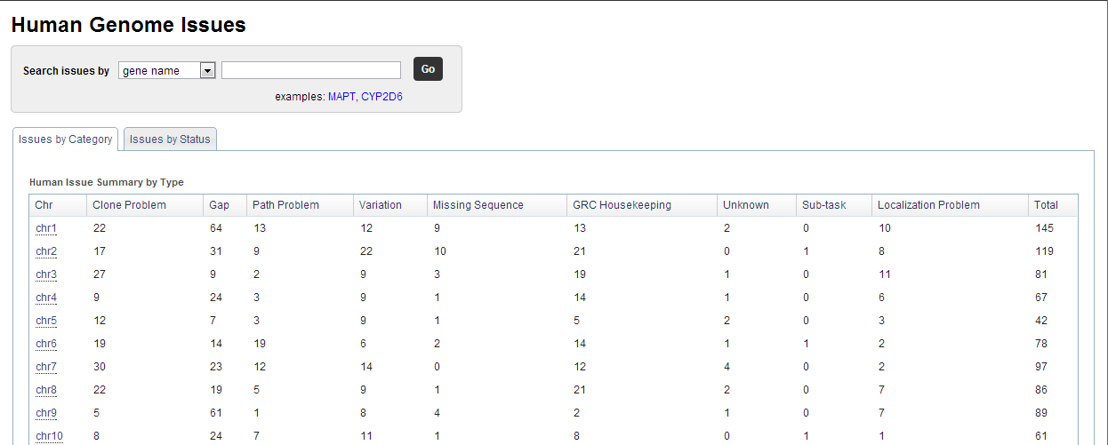
GRC Assembly Management
Issue tracking system (based on JIRA)
http://genomereference.org
Notes:
Today, all work on the human reference assembly is maintained in a centralized GRC database. Issue management software, known as Jira, is used to track all assembly changes. The GRC strives for transparency, and these issues can be viewed on the public GRC website.

Slide 37
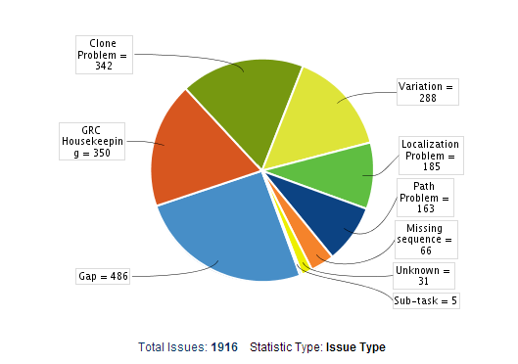
GRC Assembly Management
Notes:
This slide shows issues that have been reported on the human assembly since the GRC’s inception. The GRC classifies these issues by type as illustrated in this pie chart. These include:
Clone problems
Variation
Sequence localization
Path problems
Housekeeping (not always problems)
Gaps

Slide 38
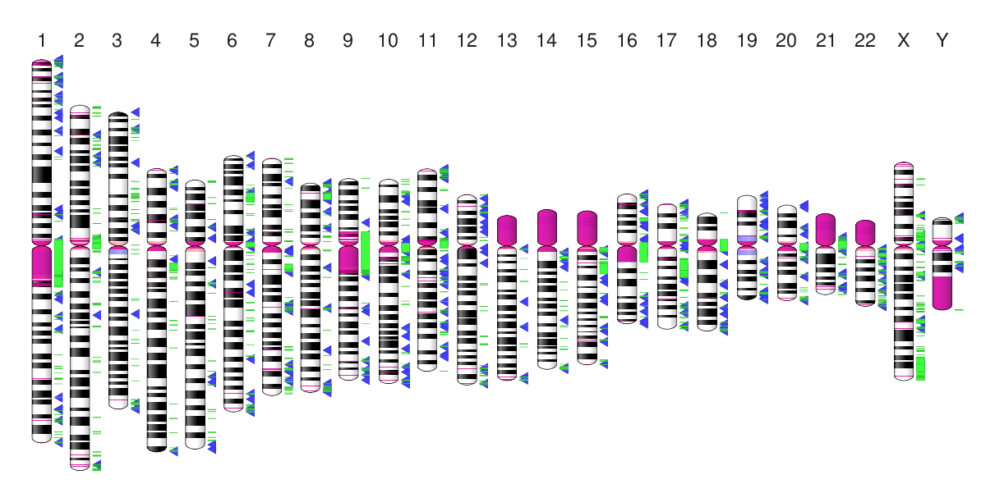
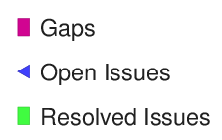

GRC Assembly Management
5 July 2011
Notes:
The ideogram on this slide shows the locations of gaps in the GRCh37 assembly as pink blocks. Alongside are the locations of all reported issues in the GRC tracking system. Resolved issues are shown as green bars, while active issues appear as blue triangles.
Note that many issues associated with assembly gaps have been resolved.
For more information about the GRC’s centralization of assembly data, please see our 2011 publication in PLoS biology.

Slide 39
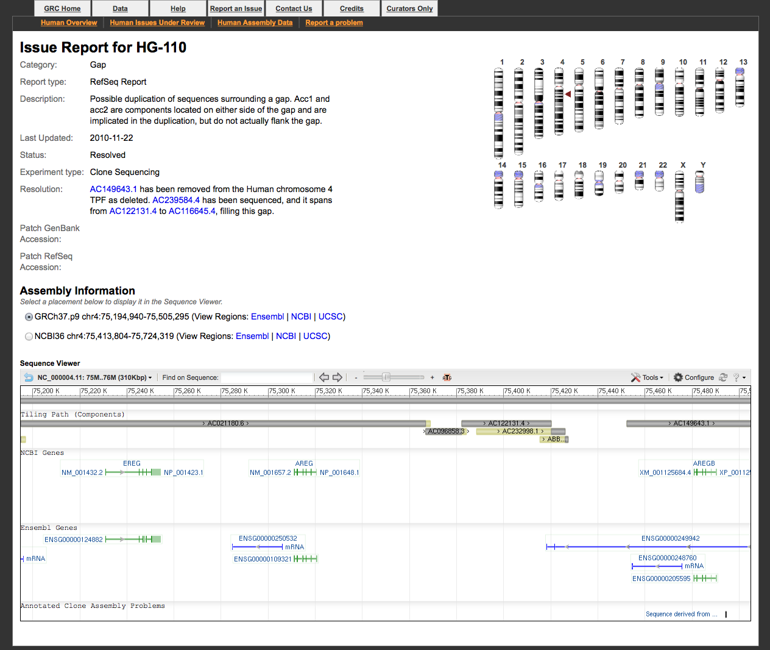
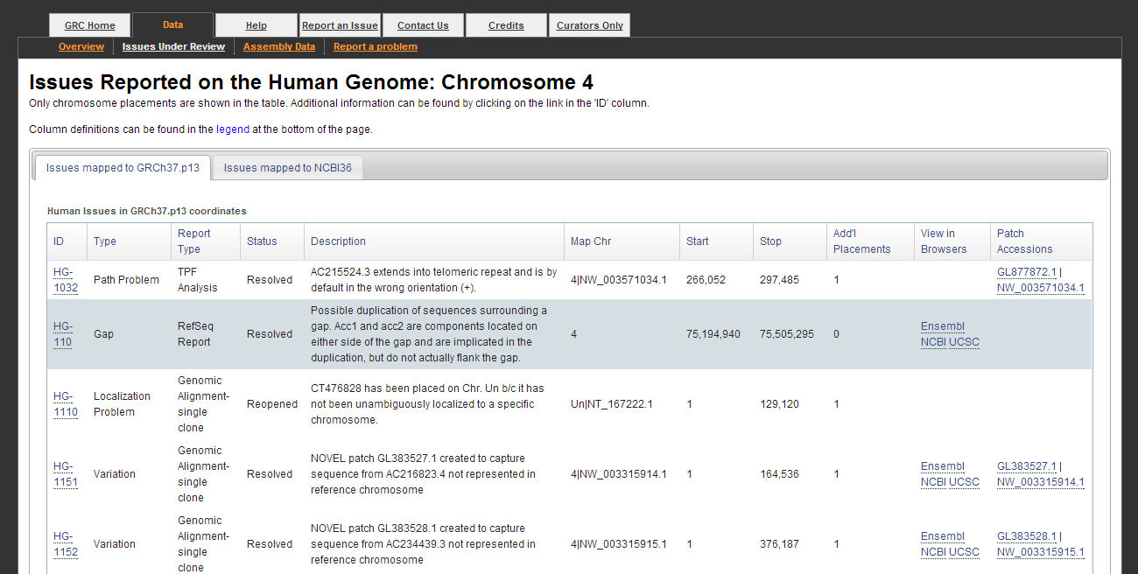
GRC Assembly Management
Notes:
You can see the specific issues on which the GRC is working at our website, as illustrated in this slide which shows the list of issues on chromosome 4. Clicking on any of the specific issue IDs in column 1, such as the one in the grey-highlighted row, will take you to an issue-specific display with additional information.
This includes:
Text describing the issue in greater detail
Ideogram showing the genomic location of the issue
Graphical view of the assembly in the vicinity of the issue, including NCBI and Ensembl gene annotation.

Slide 40
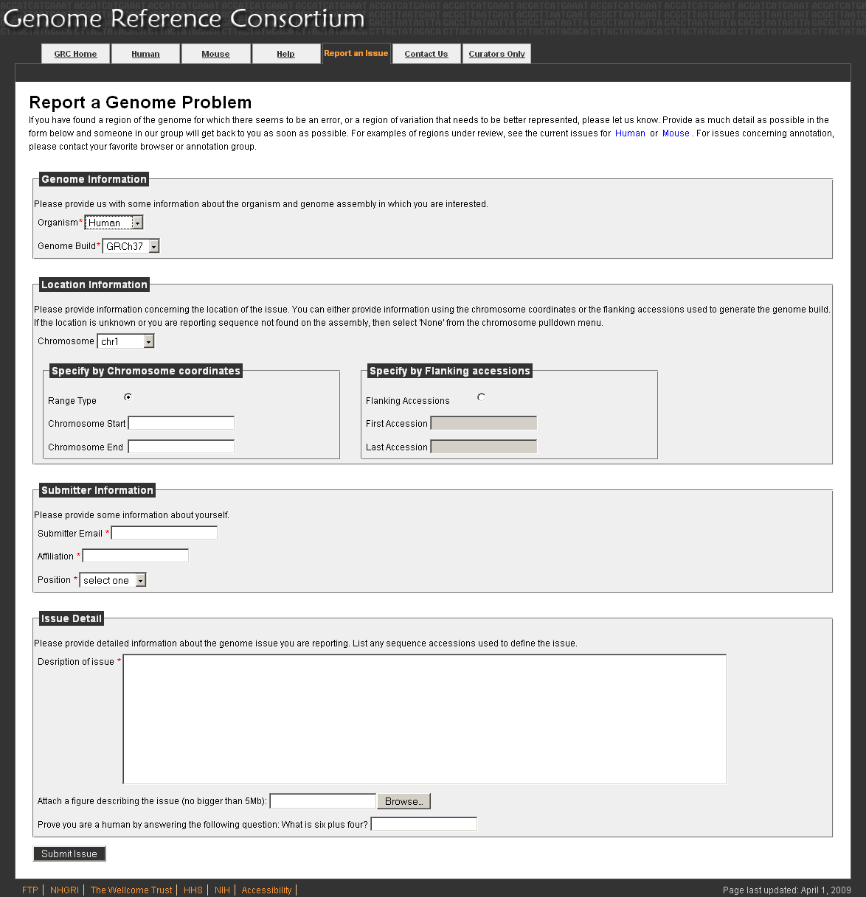
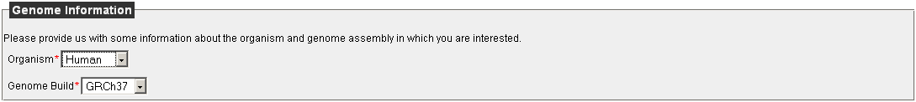
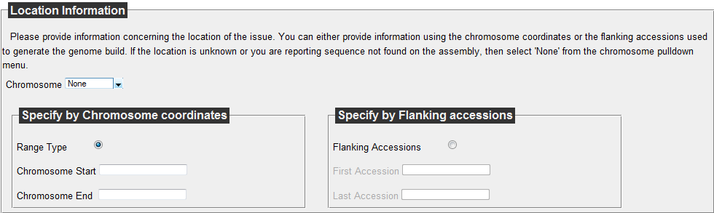
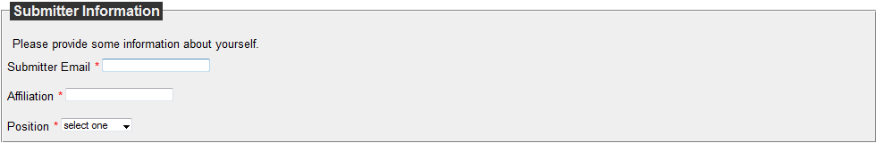
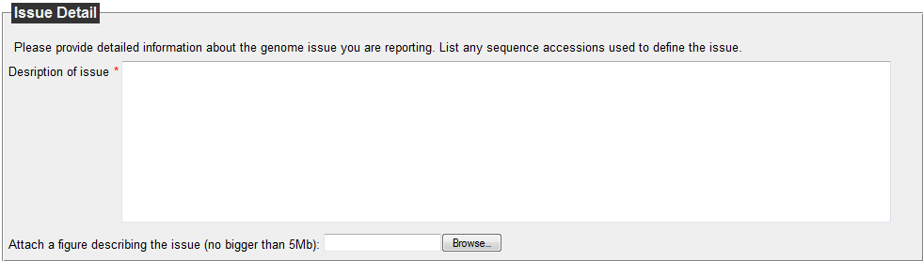
GRC Assembly Management
Notes:
If you spot a potential problem with the genome, you can report this to us and we will record the information in our tracking system. On our report page you must:
1- select the organism and build
2- tell us the location of the problem. We internally track using flanking component accessions, but you can provide the genome coordinates- we can use that and the build number to determine the flanking accessions.
3- some information about yourself so we can contact you with additional information.
4- a detailed description of the issue. You can even attach a file (and screen shots are good) to assist in describing the problem.

Slide 41
GRC Assembly Management
Tiling Path File (TPF)
ACCESSION | NAME | CONTIG
GAP | Telomere | 10000
AP006221 | XX-190A2 | Hschr1_ctg1
AL627309 | RP11-34P13 | Hschr1_ctg1
GAP | type-3
AC114498 | RP5-857K21 | Hschr1_ctg3
AL669831 | RP11-206L10 | Hschr1_ctg3
AL645608 | RP11-54O7 | Hschr1_ctg3
Notes:
If review of an issue indicates an assembly update is required, the GRC will make the necessary changes. I’d like to use the next couple of slides to talk about how the GRC manages the assembly and introduce some publicly available tools that you as users can use to assess the quality of the reference assembly.
The building of the genome starts with a Tiling Path File (known as a TPF). The TPF is defined by three columns. It only specifies the order of the clones along the chromosomes, and the known gaps. It does not specify the overlap information for adjacent sequences.

Slide 42
GRC Assembly Management
Full Dovetail
Half-dovetail
Contained
Short/Blunt
Notes:
Sequences involved in building the genome are expected to have particular types of overlaps, known as ‘full dovetails’- that is, for a +, + alignment, the alignment ends at the last base of the first clone and starts with the first base of the second clone.
The procedure used to find overlaps for the genome build specifically looks for this type of alignment between adjacent pairs. If no such alignment is available, it will look for half-dovetail or contained relationships – while we don’t necessarily want to use these for contig building, these are useful for curation purposes. The last type of alignment we might expect between adjacent components to find is a blunt or 6-bp overlap at the cloning site.

Slide 43
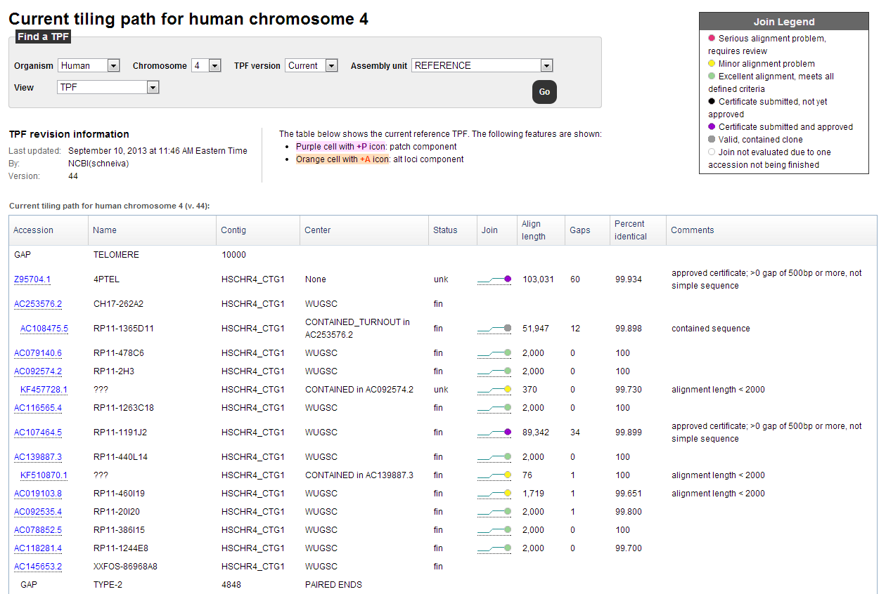
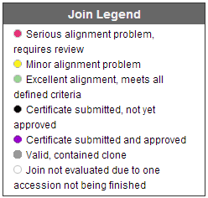
GRC Assembly Management
Notes:
TPFs are loaded to a centralized system for tracking and ongoing QA. The loaded TPFs are displayed on public webpages, as shown here. The first 3 columns are the original TPF. The remainder of the columns provide additional layers of information.
The first level of QA is to look at the overlap between adjacent sequences on the TPF. Alignments are assessed and placed into categories, shown here. These allow us to prioritize sequence pairs that need manual curation.

Slide 44
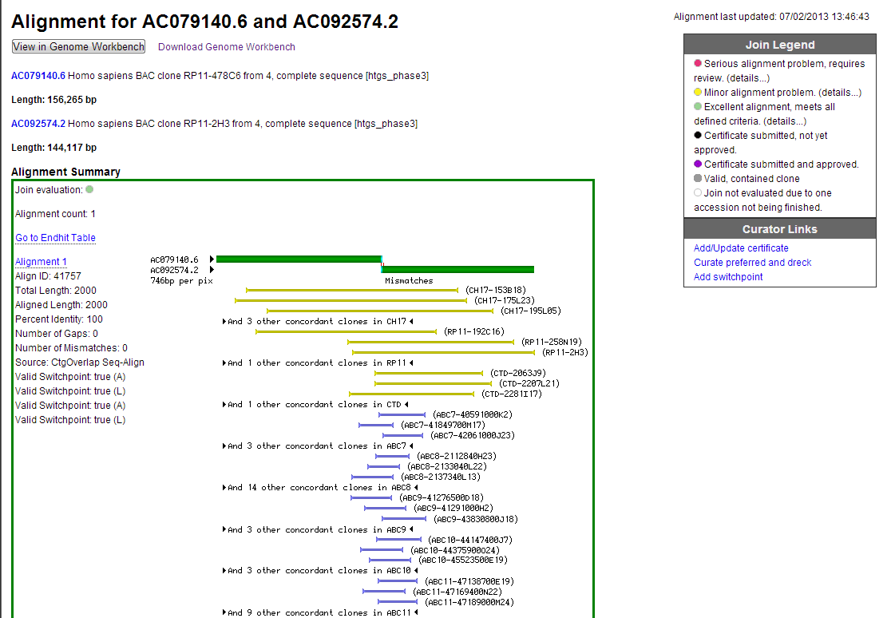
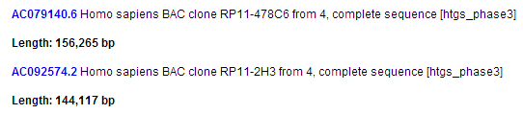
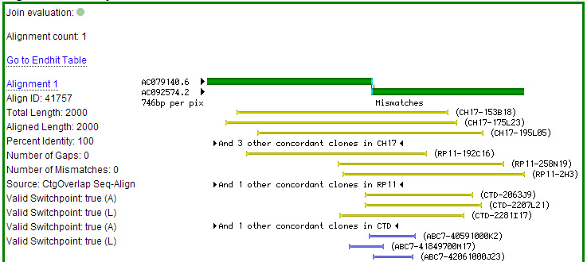
GRC Assembly Management
Notes:
Alignment information is available for each pair of components. It contains information about each component, a cartoon and sequence comparison of the alignment, along with external sequences that have concordant or discordant alignments in the vicinity of the component overlap.

Slide 45
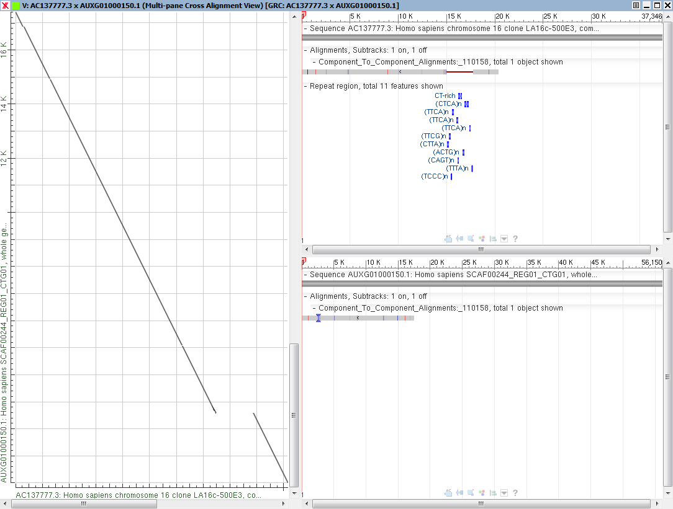
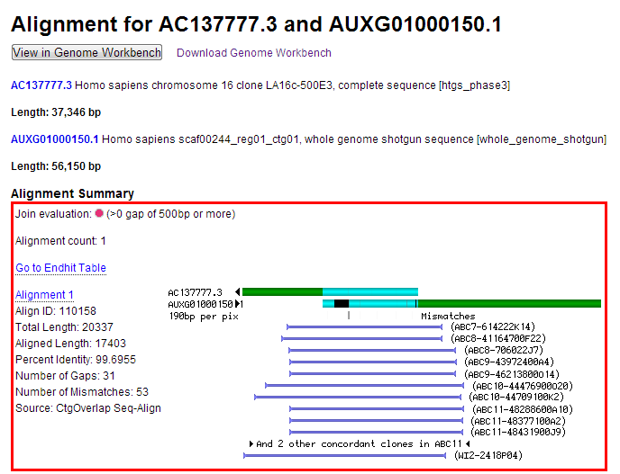
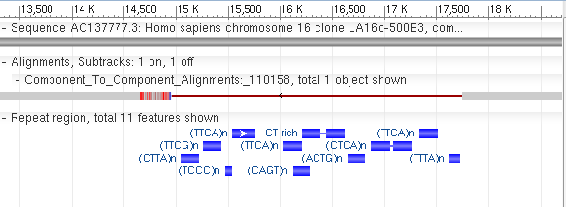
GRC Assembly Management
Notes:
When overlaps do not meet alignment criteria, they are reviewed by GRC curators. In this example, an alignment has been flagged b/c it has a gap >500 bp.
The GRC uses several tools to evaluate the alignment and determine the underlying cause of the problem. The alignment can be viewed in a publicly available software tool called Genome Workbench.
As illustrated in this screenshot, curators can view dot matrix views of the alignment (note large gap), as well as graphical views of the two sequences and alignments that include various features, such as repeats. Focusing on the region of the large gap, we see that there is RepeatMasker annotation that demonstrates the insertion in the one clone is comprised of repetitive sequence.
Curators have 3 options when alignments don’t meet the criteria:
Change one or more of the components
Curate the alignment: this is done when the alignment stored does not represent the best alignment for the sequence pair. A curator will store a new alignment for the pair that meets the alignment criteria.
Certify the alignment: this is done when the best alignment does not meet the evaluation criteria, but a curator determines that the pair should remain in the assembly.

Slide 46
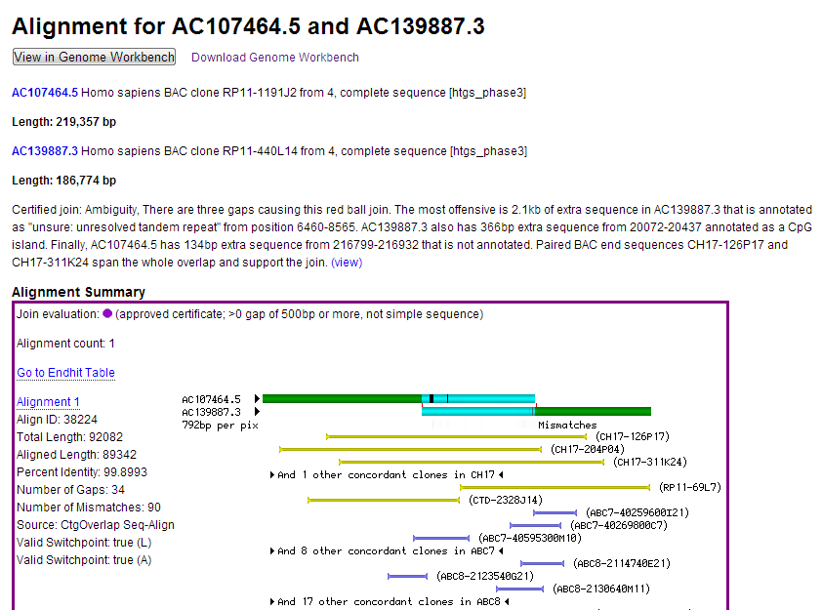
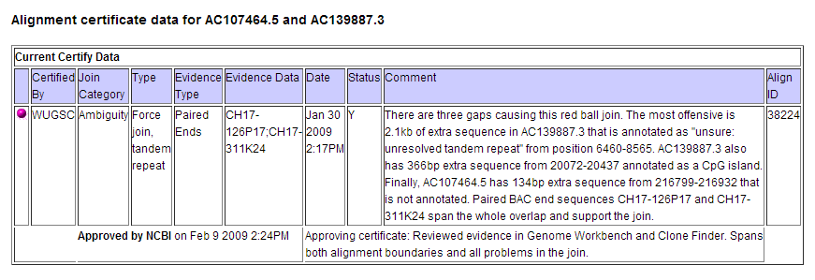
GRC Assembly Management
Notes:
This slide shows an example of an overlap that has been certified.
When certifying an overlap, external evidence supporting the alignment must be available. Evidence typically consists either of (1) sequence data from another source, (2) spanning clone ends or (3) experimental verification (such as a PCR assay detecting the join). All certificates are publicly available on the GRC website, and can also be downloaded from the GRC FTP site.

Slide 47
GRC Assembly Management
Build sequence contigs based on contigs
defined in TPF (Tiling Path File).
Check for orientation consistencies
Select switch points
Instantiate sequence for further analysis
Switch point
Representative chromosome
sequence
Notes:
Alignments refer to individual pairs of sequence. Once you know how a pair of sequences go together, you can look at stringing the pairs along into a contig. The contig is essentially the consensus sequence that is produced from the components.
To create a contig, we use the steps shown on this slide.
What are switch points? As you create the consensus sequence of the contig, the switch points tell you where to stop using the sequence from one component and begin using the sequence from the next.
If there are discrepancies in a sequence pair’s alignment, such as the indel shown here, the switch point selection will influence the outcome of the final sequence.

Slide 48
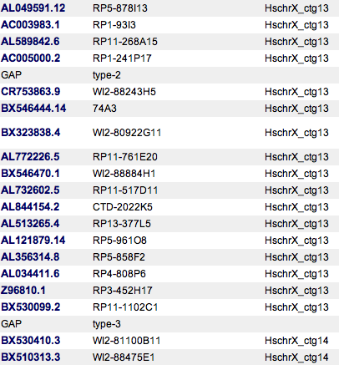
GRC Assembly Management
HschrX_ctg13
HschrX_ctg14
Notes:
Two types of gaps may be specified on the TPFs:
evidence for spanning clone exists
Become intra-scaffold gaps
no evidence for spanning clone
Become inter-scaffold gaps

Slide 49
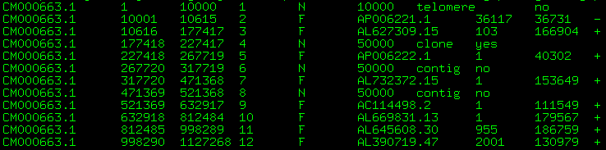
GRC Assembly Management
AGP: A Golden Path
Provides instructions for building a sequence
Defines components sequences used to build scaffolds/chromosome
Switch points
Defines gaps and types
GRC Produces
AGP
FASTA
Notes:
After all review is completed, the final sequence generated. It is represented by an AGP file, which describes component order and switch points. It also includes any gaps.
The AGP can then be used to produce FASTA files for the assembly, which is the sequence format that most users will work with.

Slide 50
GRC Assembly Management
Distributed data
Centralized Data
Old Assembly Model
Updated Assembly Model
Genome not in INSDC Database
Notes:
The second change in assembly management since the GRC assumed responsibility for the assembly was the development of an updated assembly model.

Slide 51
GRC Assembly Management
Sequences from haplotype 1
Sequences from haplotype 2
Old Assembly model: compress into a consensus
New Assembly model: represent both haplotypes
Notes:
One of the major discoveries that came from early genome analyses was the realization that there’s significantly more variation in the genome than was anticipated at the time of the human genome project. Even when dealing with a genome derived from a single individual, its possible to have 2 divergent haplotypes that confound assembly. In the original reference assembly model, there was no good way to handle variant genomic regions. Frequently, sequences from both of the two different haplotypes were inserted at these variant locations, which led to non-existent allele combinations and artificial gaps. In the new assembly model developed by the GRC, we now have a mechanism to cleanly represent multiple haplotypes in the assembly.

Slide 52
GRC Assembly Management
Assembly (e.g. GRCh37)
PAR
Non-nuclear
assembly unit
(e.g. MT)
Primary
Assembly
ALT
1
ALT
2
ALT
3
Genomic
Region
(MHC)
ALT
4
ALT
5
ALT
6
Genomic
Region
(UGT2B17)
Genomic
Region
(MAPT)
ALT
7
ALT
8
ALT
9
Notes:
To address this issue, the GRC developed a new assembly model, which was first implemented in GRCh37. As illustrated in this cartoon, in this model the “assembly” is comprised of various assembly units.
Primary assembly unit is the collection of chromosomes.
Genomic regions are defined for those areas in which an alternate representation is desired.
Alternate representations of these regions, known as alt loci, belong to their own assembly units.
Genomic regions can also be defined to represent other assembly features of interest, such as the PAR (pseudo-autosomal region).
Digression: In the reference assembly, the Y-representations of the PAR regions are identical copies of the sequence from chr. X. This reflects the original intent of the HGP to have the reference genome provide a haploid genome representation for each sequence. Thus, only one of the two allelic PAR copies was used. However, the re-use of this sequence means that reads representing the PAR will always have multiple alignments in the reference assembly. Special accounting procedures are needed to correctly handle these reads.
The reference assembly therefore is not just the is the primary assembly, but also includes the alternate loci.

Slide 53
GRC Assembly Management
UGT2B17 Region
NCBI36 NC_000004.10 (chr4) Tiling Path
AC079749.5
AC147055.2
AC019173.4
AC021146.7
AC074378.4
AC134921.2
AC140484.1
AC093720.2
TMPRSS11E
TMPRSS11E2
GRCh37 NC_000004.11 (chr4) Tiling Path
AC079749.5
AC147055.2
AC021146.7
AC074378.4
AC134921.1
AC093720.2
TMPRSS11E
GRCh37: NT_167250.1 (UGT2B17 alternate locus)
AC019173.4
AC021146.7
AC074378.4
AC226496.2
AC140484.1
TMPRSS11E2
Xue Y et al, 2008
Notes:
The UGT2B locus on human chr. 4 is an example of a region with an alternate locus in GRCh37.
In humans, the gene UGT2B17 is known to be copy number variant. Some individuals have 1 copy of this gene and others have no copies.
During the initial assembly of the human genome, components representing both versions of this region were put into the chromosome. This led to a contig gap, and the artificial (or assembly induced) duplication of TMPRSS11E which has not been shown to be CNV. The yellow bars represent the false segmental duplications that were annotated as a consequence of this assembly error.
In GRCh37 (bottom panels), the chromosome assembly was updated so that it only included components from the red haplotype. The components from the gray haplotype were placed onto the alternate locus. The dark blue bars represent anchor components, which are components from the primary assembly that are included in alternate loci to ensure a good alignment of the alternate sequence to the primary assembly.
A little later we’ll look at the implications that this duplication of sequence in the assembly can have for analyses.

Slide 54
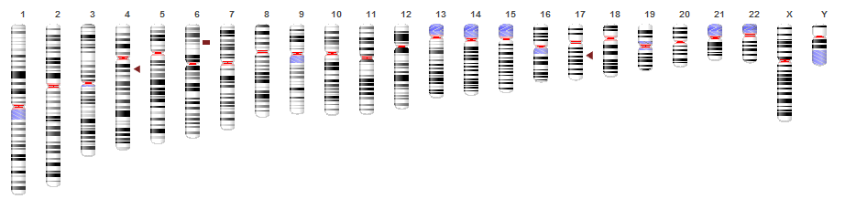

GRC Assembly Management
UGT2B17
MHC
MAPT
7 alternate haplotypes
at the MHC
Alternate loci released as:
FASTA
AGP
Alignment to chromosome
GRCh37 (hg19)
Notes:
For GRCh37, 9 alternate loci were created: 7 for the MHC, 1 for MAPT and 1 for UGT2B.
The ideograms in this slide represent the primary assembly- the linear chromosomes that most researchers are used to dealing with. In more detail, we can see chr. 6 and its associated sequences.
Alternate loci are stand-alone scaffold sequences (see in red). These get released as FASTA and AGP, just like the primary assembly.
While the alternate loci scaffolds in the updated assembly model don’t have chromosome coordinates, the GRC provides their alignments to the chromosomes, which puts them in chromosome context.
As mentioned previously, all human alternate loci sequences contain an anchor, which is a component also present in the reference chromosome. The anchor ensures the generation of a good alignment of the alternate loci to the chromosome. Previous versions of the human reference assembly did have alternate sequence representations for some loci. However, these were orphan scaffolds without chromosome context. This is no longer the case for the new assembly model.

Slide 55
GRC Assembly Management
Assembly (e.g. GRCh37.p13)
PAR
Non-nuclear
assembly unit
(e.g. MT)
Primary
Assembly
ALT
1
ALT
2
ALT
3
Genomic
Region
(MHC)
ALT
4
ALT
5
ALT
6
Genomic
Region
(UGT2B17)
Genomic
Region
(MAPT)
ALT
7
ALT
8
Genomic
Region
(ABO)
Genomic
Region
(SMA)
ALT
9
Genomic
Region
(PECAM1)
Patches
…
Notes:
This model is extensible to handling assembly updates without changing chromosome coordinates. Genomic regions where updates have occurred are defined, and scaffold sequences representing these updates are put into their own “Patches” assembly unit.
Like the alt loci, the patches are released as stand-alone scaffolds with alignments providing their chromosome context.

Slide 56

GRC Assembly Management
GRCh37.p13
178 Regions: 3.15% of chromosome sequence
131 FIX patches: add 6.8 Mb novel sequence
73 NOVEL patches: add >800kb novel sequence
Notes:
The GRC has been releasing patches to the human assembly on a quarterly cycle, and we’re now at GRCh37.p13. There are two varieties of patches:
FIX patches correct existing assembly problems: chromosome will update, patches integrated in GRCh38
NOVEL patches add new sequence representations: will become alternate loci
This ideogram shows the current distribution of patches and alternate loci, and you can see that many regions have changed since GRCh37. Note that approximately 3% of the current public human assembly GRCh37 is associated with a region that is represented by a patch or alternate locus.
This slide represents the lower bound for change, as not all updates have been released as patches. It’s time for a new assembly!
The reference is not just the is the chromosome sequences of the primary assembly unit, but also includes the alternate loci and patches, which are used to provide additional sequence representations at selected genomic regions. If you’re only using the sequences from the primary assembly for your analysis, you’re not really taking full advantage of the reference.

Slide 57


GRC Assembly Management
Chr 6 representation (PGF)
MHC (chr6)
Alt_Ref_Locus_2 (COX)
Notes:
Why should you care about alternate loci?
If you are not using the entire assembly in your efforts, you may be missing genes in your exome capture reagents. The bottom panel in this image of one of the MHC alternate loci shows a gene, HLA-DRB3 that is only present in the alternate locus.

Slide 58

GRC Assembly Management
H1
H2
17q deletion
Zody et al, 2008
Notes:
Likewise, this slide shows the alignment of probes at the MAPT locus on chr. 17 in GRCh37. These probes were originally generated from an earlier assembly version in which 2 different haplotypes were both present at the MAPT locus. Now that the haplotypes have been disambiguated, we can actually how those probes will behave in an analysis. The top panel is the H1 haplotype (now on GRCh37 chromosome) and bottom is the H2 haplotype, only represented on an alt loci. Probes with squares are missing from H2. Probes with circles show the single location on the H1 haplotype and the multiple locations on the H2. The blue line below shows the region that is commonly deleted.

Slide 59


GRC Assembly Management
Notes:
Use of the full assembly can also improve variation analyses. Here we see short reads that align to sequence unique to the alt, using SRPRISM, an alt aware aligner.

Slide 60

GRC Assembly Management
reads
On-target alignment
alt/patch
Off-target alignments
chromosome
(n=122,922)
Notes:
If you’re not using the full assembly, your reads may map to the wrong place!
We’ve been doing some analyses to investigate the severity of mapping errors that can occur when alts/patches aren’t used in alignment target sets. In this study, we looked at the behavior of simulated reads sourced from GRCh37.p9 patch/alt unique sequence aligned to GRCh37 primary assembly. We asked what happens to these reads when their true target is missing. We aligned the reads either as singletons or pairs, using two different aligners (BWA and srprism).
The chart in this slide shows that, regardless of approach, while 25% of these reads failed to align, nearly three-quarters have an off-target alignment. These off-target alignments are likely to result in errors in variation analyses.
This analysis demonstrates the value in including assembly updates when performing analyses.

Slide 61

GRC Assembly Management
Notes:
Since commonly used short reads aligner like BWA can’t currently handle the sequence duplication introduced by anchors and other non-unique sequences in alts/patches, new tools are needed so that users can make use of the full assembly. However, in the interim, we are also looking at approaches that may help users make use of existing tool chains. For example, we are developing a mask that hides the duplication in the alts/patches. In this way, BWA can still be used, but users can take advantage of the value added by the alts/patches. In this slide, you can see the mask we’ve generated for this NOVEL patch which has an insertion relative to the reference, but is identical for much of the remaining length.
The mask shown here was tailored for use with alignments of 101bp reads; parameters may need to be adjusted for other read lengths.
Notably, the mask can be applied to an alt/patch or to the chromosome. The latter is desirable for FIX patches, where you want the reads to align to what the chromosome will look like, not to the potentially erroneous chromosome sequence.

Slide 62


GRC Assembly Management
Notes:
This slide illustrates how the mask suppresses duplicate alignments.
Simulated reads were aligned to either the GRCh37 primary assembly only, or to the full GRCh37.p9 assembly. Without the novel patch, you can see many poor alignments in a region of chr. 10 that has alternate representation. These mismatchy alignments are eliminated when the novel patch is included in the target set (2nd row). The same effect is still visible when the mask is applied (3rd row).
The efficacy of the map in reducing duplicate alignments is visible when looking at reads aligning to the novel patch. Can see that the density of alignments in the masked regions is reduced.

Slide 63

Masks and alt aware aligners reduce the incidence of ambiguous alignments observed when aligning reads to the full assembly
GRC Assembly Management
Mask1: mask chr for fix patches, scaffold for novel/alts. Mask2: mask only on scaffolds
Notes:
This slide provides some quantitation for these assertions. Simulated reads were aligned to GRCh37 primary only, or to the full assembly with either BWA or srprism, the alt aware aligner. For BWA, we looked at masking the alts/patches only, or masking a combination of alts/patches and the chromosome. We then looked at the incidence of reads with unique or multiple alignments.
The second column shows an increase in multiple alignments when reads are aligned to the full assembly with BWA and no mask. Use of either masking approach essentially eliminates the increase. Of note, srprism, the alt aware aligner does not need a mask to prevent ambiguous mappings. We’ll be following up this analysis with some real reads from NA12878.
Ultimately, we are looking at ways to make resources like the mask available to more users. We plan to publish these analyses when complete and are looking at ways to distribute masking files with the assembly.

Slide 64
GRC Assembly Management
Distributed data
Centralized Data
Old Assembly Model
Updated Assembly Model
Genome not in INSDC Database
Genome not in INSDC Database
Genome in INSDC Database

Slide 65
Outline
Reference Assembly Basics
GRC: Assembly management and dataflow
GRCh38
Accessing the assembly and data
http://genomereference.org

Slide 66

GRCh38 Impact
GRCh38
Notes:
The GRCh38 assembly will be released this fall. We are currently resolving a data issue uncovered a data issue during processing and expect to resume submission of the assembly soon. In this next section, I’d like to highlight some of the new features you will find in the updated assembly. We’ll start with some assembly stats.

Slide 67



GRCh38 Impact
GRCh37 Scaff N50: 44,983,201
GRCh37B Scaff N50: 62,124,159
GRCh37 Contig N50: 38,440,852
GRCh37B Contig N50: 49,319,739
Notes:
Since GRCh38 isn’t yet available, in some slides I will show stats from a dress-rehearsal (internal, analysis-only) build known as GRCh37B produced earlier this year in preparation for this fall’s public assembly release. Can think of it as a lower bound for change.
First: look at changes in chromosome length. While total length changes vary, can see that ungapped sequence length increased for nearly all of the chromosomes, reflecting the addition actual sequence to the assembly. In cases where ungapped length got shorter, these reflect some instances where we removed haplotypic expansions from the chromosomes.
Second: The analysis only-build was also aligned to GRCh37.p12, and the distributions of the ungapped unaligned sequence were examined. This reflects the distribution of novel sequence added in the updated assembly.
Third: The large increases in scaffold N50s can be attributed to the addition of WGS at assembly gaps. In several cases, these spanned GRCh37 interscaffold gaps.

Slide 68

GRCh38 Impact
Notes:
Unlocalized sequence in GRCh37 vs. GRCh38. This is a count of scaffolds, not the lengths. Must login to NCBI to get lengths…
Take homes:
Many GRCh37 unlocalized and unplaced sequences have been placed or localized
Most of the unlocalized/unplaced sequences new to GRCh38 come from admixture mapping/decoy capture

Slide 69



GRCh38 Impact
Notes:
Data for alt loci comes from GRCh38 (pre-centromere update), not GRCh37B
Alt loci explosion!
More of them (262 in GRCh38)
Where they’re located (regions; a region contains 1 or more alt loci scaffolds)
There are more overlapping alts than ever (max is 35, at LRC/KIR region)

Slide 70
GRCh38 Impact
Major Features of GRCh38
Modeled Centromeres
Individual base updates
Fixed tiling path/assembly errors
Addition of novel sequence

Slide 71
GRCh38 Impact
CENTROMERES

Slide 72
GRCh38 Impact
Mismatches MAF = 0
n=15,244
MAF<5%
Mismatch in pseudo/pr txpt
n=1413
61-mer analysis set
9664
1kG high-confidence set
1358
Annotator and clinical requests
n= ~260
4222
MAF=0
Insertions
n=834
MAF=0
Deletions
n=1541
Notes:
The human genome is approximately 2.85 billion bases and the finished human reference assembly accurate to an error rate of 1 per 100,000 bases. While this represents the highest quality mammalian genome assembly in existence today, it still means that an approximate 28 thousand bases are incorrect. The GRC made the correction of erroneous bases a priority for GRCh38.
What bases will be updated in GRCh38?
The GRC began by considering updates for ~15K bases with MAF=0. These “never seen” bases were identified in 1 or both of two analyses: (1) a high-confidence subset of the original MAF=0 calls defined by 1kG and (2) an independent k-mer analysis performed by Jared Simpson at WTSI looking for GRCh37 bases never seen in 1kG reads.
The kmer analysis also identified about 2000 indels with MAF=0
There are also 1413 bases with MAF<5% (but >0%) that overlap pseudogenes, processed transcripts or polymorphic pseudogenes
Lastly, there are ~200 base update requests from annotators and clinical labs with various MAFs that the GRC considered.
All together, there are ~20K bases that were initially considered for update.

Slide 73

GRCh38 Impact
Essential splice site: 4
Non-syn coding (delet): 6
Downstream
Upstream
Intergenic
Intronic
Mismatches (n=15,244)
Notes:
VEP results for mismatch bases with MAF=0. Take-home here is that most changes are not in CDS. But there are also functional consequences.
We’ve also run VEP on the indel MAF=0 set (not shown); there are ~20 cases in which the current reference base has a severe consequence on CDS.
There are a higher proportion of functional consequences in the set of Jira base update requests.

Slide 74

GRCh38 Impact
Pile-Up Analysis: “Never Seen” Mismatched Bases Originating from RP11 Components
79% of these bases are heterozygous in RP11 WGS
Notes:
However, the GRC didn’t actually attempt to update all of these bases. In an effort to determine whether bases with MAF=0 were sequencing errors or unrecognized variants, we performed a pile-up analysis for a subset of the bases for which we had WGS data.
Pile-Up Analysis of RP11 “Never Seen” Bases:
Identify the subset of 1kG “never seen” mismatch bases that were in RP11 components
Identify RP11 WGS reads that align to bases in question and determine RP11 sequence at base
In graph: (X axis is chromosomes)
Purple: Proportion of “never seen” bases that are heterozygous in RP11 (hetalt: not errors)
Red: Proportion of “never seen” bases that are not seen in RP11 (hmalt: genuine errors)
Across all chromosomes: 79% “never seen” mismatch bases are heterozygous in RP11 WGS, indicative of unrecognized variation, rather than sequencing error.

Slide 75


GRCh38 Impact
GRCh37 Insertions Originating from RP11
GRCh37 Deletions Originating from RP11
17% heterozygous in RP11 WGS
18% heterozygous in RP11 WGS
Notes:
Performed similar analyses for the indels (used a 70% cut-off for homozygosity calls):
These faired better; most “never seen” indel calls found in RP11 bases were supported by analysis of RP11 reads
In graph: (X axis is chromosomes)
Purple: Proportion of “never seen” bases that are heterozygous in RP11 (hetalt: not errors)
Red: Proportion of “never seen” bases that are not seen in RP11 (hmalt: genuine errors)
Across all chromosomes: 17% and 18% of “never seen” insertions and deletions, respectively are heterozygous in RP11 WGS

Slide 76

GRCh38 Impact
Notes:
Based on the pile-up analysis, the GRC decided to take a somewhat more conservative approach to updating bases.
“Never seen” bases originating from RP11 components that were deemed to be homozygous for the GRCh37 allele in the RP11 WGS pile-up analysis were dropped from the update set.
“Never seen” bases originating from RP11 components that were deemed heterozygous in the RP11 WGS pile-up analysis were only retained in the update set if they had a functional effect, as determined by the Ensembl Variant Effect Predictor.
“Never seen” bases originating from non-RP11 components were retained in the update set, due to absence of any evidence contradicting the MAF=0 calls.
“Rare” bases were only retained in the update set if they had a functional effect, as determined by the Ensembl Variant Effect Predictor.
Special request: generally updates to provide coding alleles of polymorphic pseudogenes

Slide 77

GRCh38 Impact
Notes:
The GRC cannot simply change bases in the assembly. All base changes must be accomplished via the TPF files with an INSDC-accessioned sequence containing the desired base. With this constraint, the GRC used several approaches to update assembly bases:
If bases were in the overlap between 2 TPF components, change TPF switch points
If bases were in GRC-owned TPF components and review of underlying traces revealed error, update the component accession
Identify components in INSDC databases that align to region of interest and have alternate base (clone-based or WGS contigs from other human genome sequencing projects)
Perform PCR on genomic DNA and accession product
Assemble WGS reads from 1kG or RP11 genome sequencing projects into “mini-contigs” (50-500 bp) and submit to INSDC for accessioning (with permission from project)
Cortex_con software: Mario Caccamo/Zam Iqbal
Validate output: only accept contigs that differ from GRCh37 at intended base (and have expected change)
This approach was used for the vast majority of base updates
This slide shows the outcome of the base updates the GRC attempted. Overall, the GRC was able to produce or identify and INSDC sequence that could be used to change approximately 90% of bases for which it sought an update. The next slides show some examples of bases that were updated.

Slide 78


GRCh38 Impact
Notes:
This panel shows reads from NA12878 aligned to chr. 19 that highlight a base with MAF=0 in the LIN37 locus. This creates a non-consensus splice site. A second base with MAF = 0 located in a second LIN37 exon is not shown in this view.
Two mini-contigs were constructed from 1kG reads to address these bases. In the top panel, the alignments of these contigs and the LIN37 mRNA to GRCh37 are shown. The red lines indicate the base discrepancies in the mRNA and contigs relative to GRCh37. The orange line indicates the non-consensus splice site. In the bottom panel, we see the LIN37 transcript aligned to the patched sequence. Note that the discrepancies are now gone.

Slide 79


GRCh38 Impact
Dennis et al., 2012
1q32
1q21
1p21
1p21 patch alignment to chromosome 1
Notes:
I next want to highlight some tiling path updates that were made.
Top panel: Work by Evan Eichler’s lab identified several gene duplication events associated with the SRGAP2 family of genes, which play a role in cortical development. His studies found that not only were the 3 SRGAP2 human paralogs incompletely sequenced in GRCh37, but that allelic and paralogous sequences had been mixed in the assembly. Only by use of a single haplotype resource (CH17 BAC library clones) was it possible to disambiguate the correct paths at each locus.
These updates have several implications for users.
1p21 is shown as an example showing how this path update has implications for missing sequence/novel genes. Bottom panel shows GRCh37 chr.1 aligned to the updated path. Note that there are large regions of the updated path that contain genes.

Slide 80


GRCh38 Impact
HYDIN: chr16 (16q22.2)
Doggett et al., 2006
HYDIN2: chr1 (1q21.1)
Missing in NCBI35/NCBI36
Unlocalized in GRCh37
Finished in GRCh38
Alignment of HYDIN2 Genomic, 300 Kb, 99.4% ID
Alignment of HYDIN2 Genomic, 300 Kb, 99.4% ID
Alignment of HYDIN CHM1_1.0, >99.9% ID
Alignment of HYDIN CHM1_1.0, >99.9% ID
Notes:
The SRGAP2 tiling path updates also have implications for variant calling. The human genome contains two HYDIN loci: one on chr. 16, and HYDIN2 on chr. 1. The HYDIN2 locus was absent from previous assembly versions and on an unlocalized scaffold in GRCh37. The SRGAP2 retiling efforts localized HYDIN2 to 1q21, an update that will be included in GRCh38.
This slide shows the alignment of the CHM1 copies of the HYDIN2 and HYDIN genes to the chr.16 HYDIN locus in the GRCh37 assembly. The HYDIN2 alignment reflects paralogous sequence differences, while the HYDIN alignment reflects allelic differences. The alignments show that the loci are highly similar, explaining why it was so difficult to disambiguate the two genes, a feat that was ultimately only accomplished with the use of the CHM1 single haplotype resource. In fact, the sequences are so similar, in NCBI34, sequences from the two genes were mixed at the same locus.
Zooming in, we see an SNV in the alignment of HYDIN2 that occurs at the same position of an annotated HYDIN SNP. Given the poor representation of the HYDIN2 locus in previous assemblies, it raises the question of whether this SNP represents actual variation in HYDIN or a false SNP reported due to improper alignment of HYDIN2 sequences at the HYDIN locus.

Slide 81

GRCh38 Impact
Other Major Tiling Path Updates
Single CHM1 haplotype paths for:
  1p12, 1q21, 1q32: SRGAP2
  IGH
  LRC/KIR
  CCL3L1 (17q21)
OM-guided
  10q11
  Chr. 9 peri-centromeric inversion
Notes:
The GRC has been using several lines of evidence and techniques to identify and correct tiling path errors in GRCh37, including:
Optical maps (Schwartz/OpGen): chr. 10q11 and chr. 9 retiles
Structural variation analyses (Evan Eichler’s group): chr. 1 retiles and others
Admixture mapping reports (Genovese/McCarroll): PRIM2 retile and others
Admixture mapping by Giulio Genovese in Steve McCarroll’s lab identified a collapsed triplication of the PRIM2 locus in GRCh37. Set of clones on chr. 6 p-arm was incorrectly localized, which resulted in the annotation of a hybrid transcript. In addition, id’d addn’l seqs representing a 3rd gene copy on chr. 3. In collaboration with Giulio, the GRC has now updated the assembly so that all 3 copies have representation. The chr. 3 copy remains unlocalized at this time.
Other regions that have undergone major tiling path updates are listed here.

Slide 82


GRCh38 Impact
NOVEL GENES!
GRCh37.p13: 211 genes found only on alt loci and patches
Notes:
The GRC has also been working to add novel sequence to the assembly, particularly that which may include genes.
Novel genes! Segmental duplication at 17p11.2 that was missing in GRCh37 has been partially addressed in GRCh38 (previously released as a FIX patch).
UCSC browser image: increased density of SNPs in this genomic region; see association with KCNJ12
Gbench image:
Top panel: GRCh37. Gap-adjacent region highlighted in purple was updated for patch (see alignment diffs)
Bottom panel: Updated path. Purple region is replacement sequence. Alignment shows how patch extends into gap. Pick up gene KCNJ18, capturing part of the missing segmental duplication.

Slide 83


GRCh38 Impact
Sudmant et al., 2010
Notes:
But there’s still missing sequence: Sudmant paper showing most under-represented genes in the assembly. The problem here is that we don’t necessarily know where these belong. Not necessarily in gaps.

Slide 84

Genovese et al., 2013
Notes:
The GRC has also been working incorporate unlocalized and unplaced genomic sequences into the chromosomes, many of which were placed via admixture mapping by Giulio Genovese.
This slide shows the locations of GRCh37 unlocalized/unplaced scaffolds (3 digits), HuRef scaffolds (5 digits) and BAC clones (green). Blue indicates a confirmatory FISH placement for the sequence. As indicated here, many of these previously unlocalized and unplaced sequences map to peri-centromeric regions.

Slide 85

GRCh38 Impact
1000G decoy sequence, viewed by:
GenBank alignment
Percent Repeat Masked
Repeat Mask type
Sequence Source (HTG, HuRef, ALLPATHS)
In a preliminary analysis, 90% of NA12878 reads that previously aligned uniquely to the decoy sequence had an alignment to the updated assembly.
Notes:
Another source of novel sequence that has been added in the updated assembly is the 1kG decoy sequence. The decoy is a 35 Mb collection of human sequences that have low identity to GRCh37. It has been demonstrated that inclusion of the decoy sequence in GRCh37 alignment target sets improves read mapping and SNP calling.
While the decoy is valuable in helping to capture reads, the decoy doesn’t provide chromosome context. Thus, if we can place much of the decoy in chromosome context for GRCh38, that adds even more value to the assembly.
This slide shows the breakdown of the decoy: by source (bottom), by alignment to GenBank, and by amount and type of repeat.
Preliminary analysis: How well have we captured decoy sequence in the assembly? Check alignment of reads that previously aligned only to the decoy to GRCh37B+model centromeres.
Read Sample: NA12878.mapped.ILLUMINA.bwa.CEU.low_coverage.20120522.8levels.csra
Phase 2 data
Aligned by BWA
Only using reads that align uniquely to decoy, with MAPQ >=20 (~1.77 million)
Realigned to GRCh37B + model centromeres
SRprism
Alignment parameters set to match BWA parameters from original alignment

Slide 86
GRCh38 Impact
Where is the decoy sequence in GRCh38?
Alt loci (low repeat content)
Model centromeres (high repeat content)
Unlocalized/Unplaced Scaffolds
Chromosomes
Notes:
70% of low RM content decoy derived from HTG sequence is captured in alt loci. Only 25% captured in chromosomes and 5% captured in unloc/unplaced.
Much of the high RM content decoy is alpha-satellite; this will be captured in the model centromeres.

Slide 87
Outline
Reference Assembly Basics
GRC: Assembly management and dataflow
GRCh38
Accessing the assembly and data
http://genomereference.org

Slide 88


Accessing the Data

Slide 89


Accessing the Data
Notes:
The GRC human overview page contains links for downloading the assembly and related data.

Slide 90

Accessing the Data
Notes:
Human overview page also provides access to the GRC blog, a list of recently resolved issues and references.
At the bottom is a table with information about the latest patch release.

Slide 91



Accessing the Data
Notes:
This section includes a table that lists the current regions defined in the assembly. Clicking on any region name in the table will take you to the corresponding region page.

Slide 92




Accessing the Data
Notes:
The region page provides:
Location of region, including ideogram
List of Jira issues associated with the region
Patch and alternate loci Sequences associated with the region
Graphical view of the region

Slide 93


Accessing the Data
NCBI Genes, Ensembl Genes, Annotated Clone Problems, Segmental Duplications
Notes:
Closer look at graphical view. See alignments of alternate loci, as well as genes, annotated clone problems and segmental duplications.

Slide 94


Accessing the Data
Notes:
The assembly data tab takes you to a page that provides stats for the assembly. These include global stats,

Slide 95

Accessing the Data
Notes:
Chromosome lengths

Slide 96

Accessing the Data
Notes:
And gap counts.

Slide 97



Accessing the Data
Notes:
GRC data in the UCSC browser. Assembly-related tracks are highlighted.
The LiftOver tool will help users convert data from one set of assembly coordinates to another.

Slide 98


GRCh38 in Ensembl
GENCODE gene set
GRCh38 will be incorporated into the existing Ensembl interface. Features such as genes, variation, regulation will be remade or remapped onto the new genome. Nearly 500 tracks are available.

Slide 99



Accessing the Data

Slide 100



Alternate sequences in Ensembl
Use the Region comparison view to see the difference between the patch and primary assembly
Haplotypes and patches on the chromosome
A fix patch around the ABO gene
The GRC alignment track indicates edits

Slide 101



View your data on the Genome
Zoomed out
Zoomed in
Red bases show mismatches
Follow the link from the homepage

Slide 102



Transition to GRCh38 in Ensembl
INSDC coordinates identify the assembly as well as the position
Convert coordinates between assemblies
Our blog series details our progress with GRCh38
Ensembl.info

Slide 103




Remap Set up slide
Notes:
NCBI also has resources to help users deal with chromosome coordinate changes when they do happen in major releases. The Remap tool, enables users to remap features from one assembly version to another.
Users can select the assemblies they want to map between, and the tool recognizes data in many formats.
The tool uses assembly-assembly alignments to project the features from one assembly to the other.

Slide 104



Accessing the Data
Notes:
NCBI MapViewer can be configured to display assembly-relevant tracks.

Slide 105


Accessing the Data
Notes:
There is a region map available in MapViewer. Clicking any of the region name will provide users with details about the region.

Slide 106

1000 Genomes Browser: http://www.ncbi.nlm.nih.gov/variation/tools/1000genomes
GeT-RM Browser: http://www.ncbi.nlm.nih.gov/variation/tools/getrm
Variation Viewer: http://www.ncbi.nlm.nih.gov/variation/view (coming Fall 2013!)
Notes:
There are also several browsers at NCBI that can be configured to show assembly related data. This image here is from the 1kG browser.
A new browser, the variation viewer, will be released soon that will serve as an entry point for many users interested in accessing assembly data. In this new browser, the relationships among the various assembly units are provided and users can easily navigate between sequences from different assembly units.

Slide 107


Notes:
Browser tracks can be configured with the Configurator; this is an example from the 1kG browser.

Slide 108


Sequence Bar
Tiling Path
Segmental Duplications, Eichler Lab
1000 Genomes strict accessibility mask
Annotated clone assembly problems
Notes:
Assembly tracks of interest currently available. These images are also from the 1kG browser.
Top: zoomed out, appear as graphs
Bottom: zoomed in, appear as individual features

Slide 109


GRC Curation Issues
ClinVar Short Variations
dbSNP Build 138 based on annotation run 104
Model based paralogous sequence differences, NCBI annotation run #
Paralogous/pseudo gene alignments, NCBI annotation run #
Single Unique Nucleotide (SUN) map, Sudmant 2010
ClinVar Long Variations
Notes:
This slide highlights several new assembly related tracks that will soon be available, including some that are relevant for genome analysis:
GRC curation issues
SUN map
Paralogous sequence alignments
Some variation tracks (see variation in this gene)
GBA (Glucosidase, beta, acid)

Slide 110

Accessing the Data
http://twitter.com/GenomeRef
grc-announce@ncbi.nlm.nih.gov

Slide 111

Accessing the Data
http://genomeref.blogspot.com/

Slide 112


Slide 113


Slide 114


Slide 115


Slide 116



Accessing the Data

