Slide 1





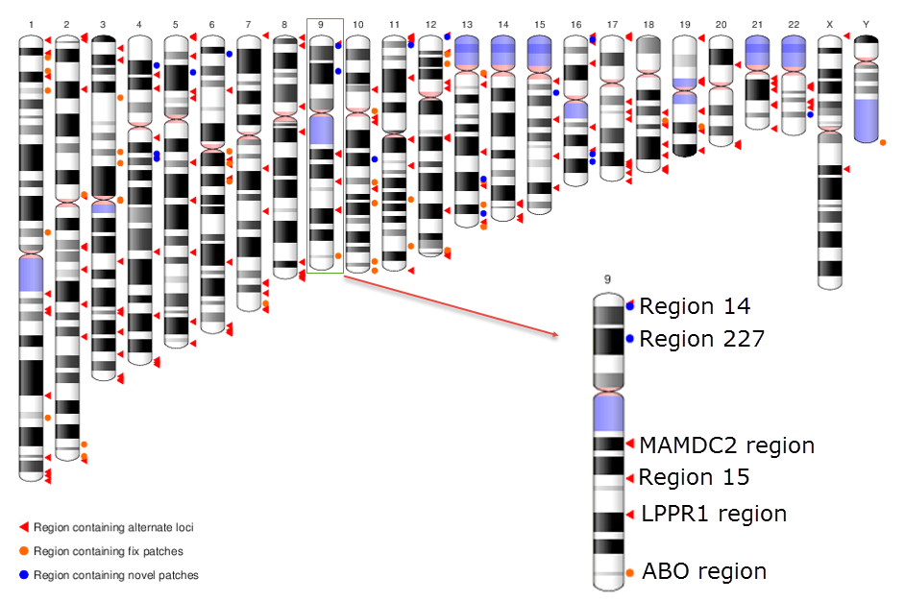
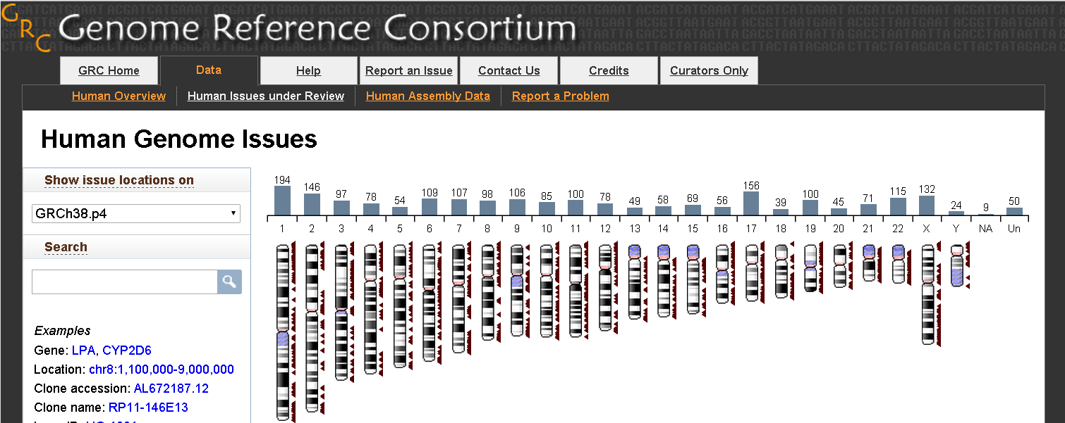

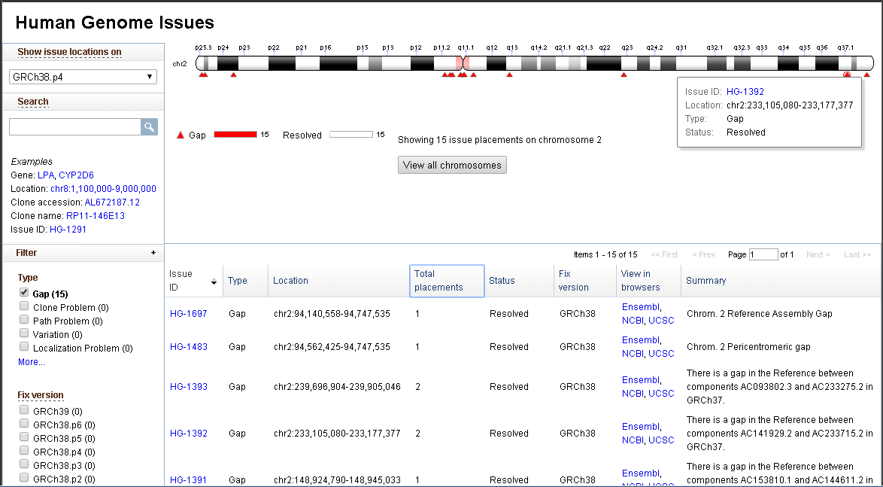
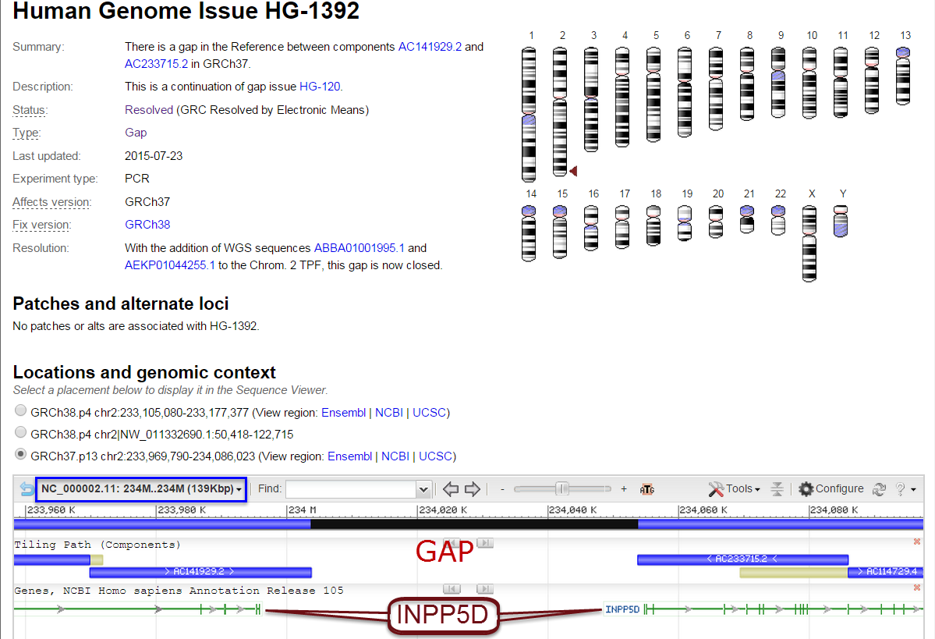

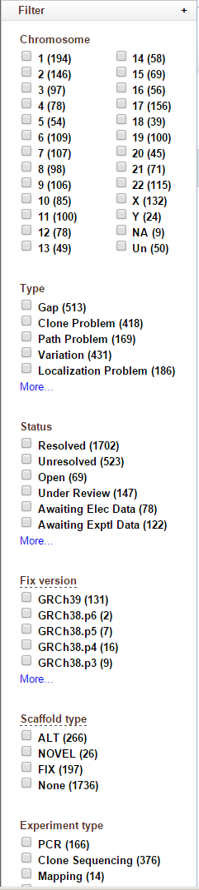

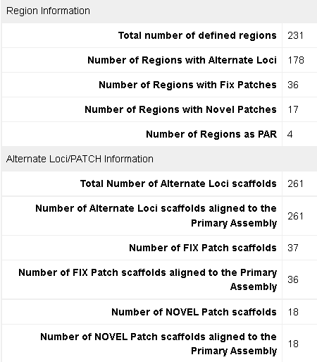
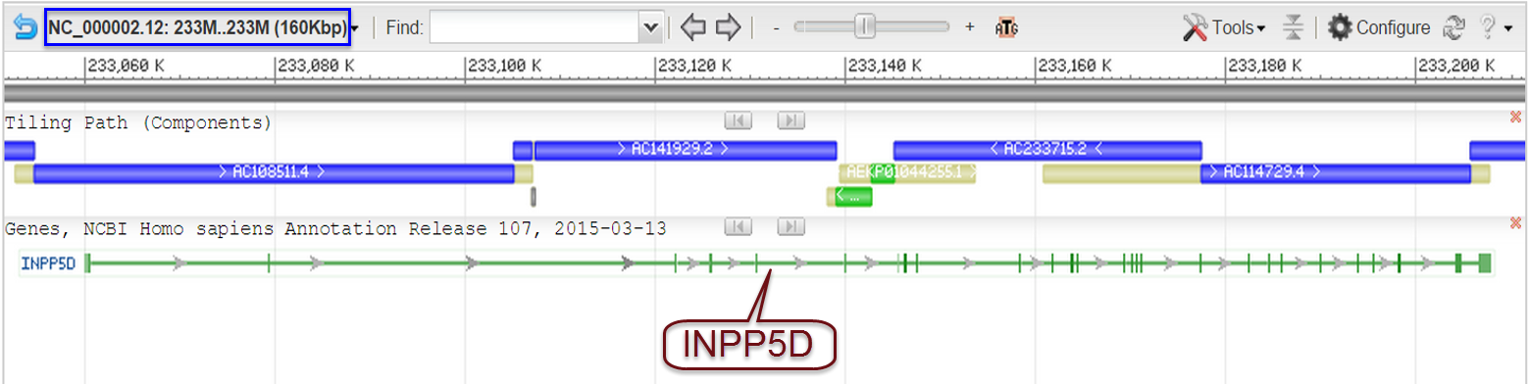
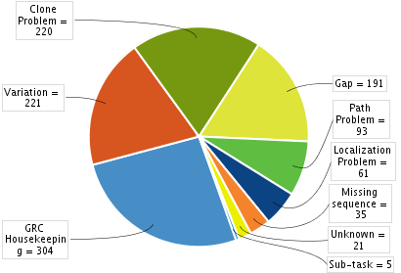
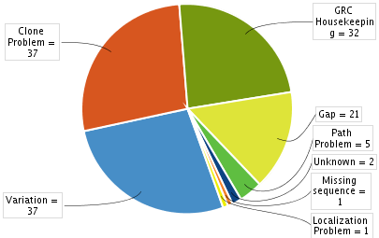
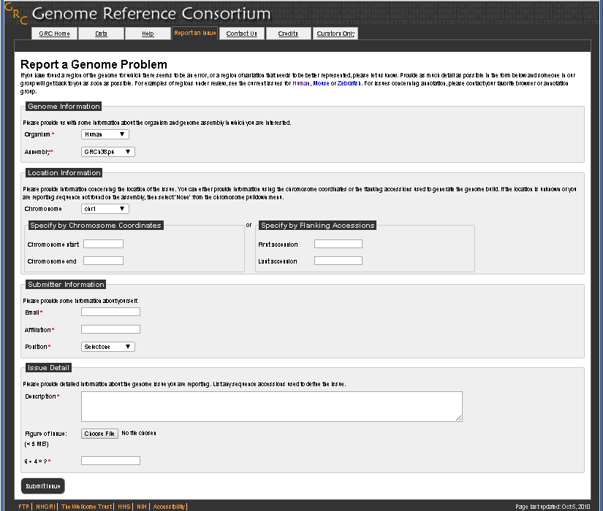
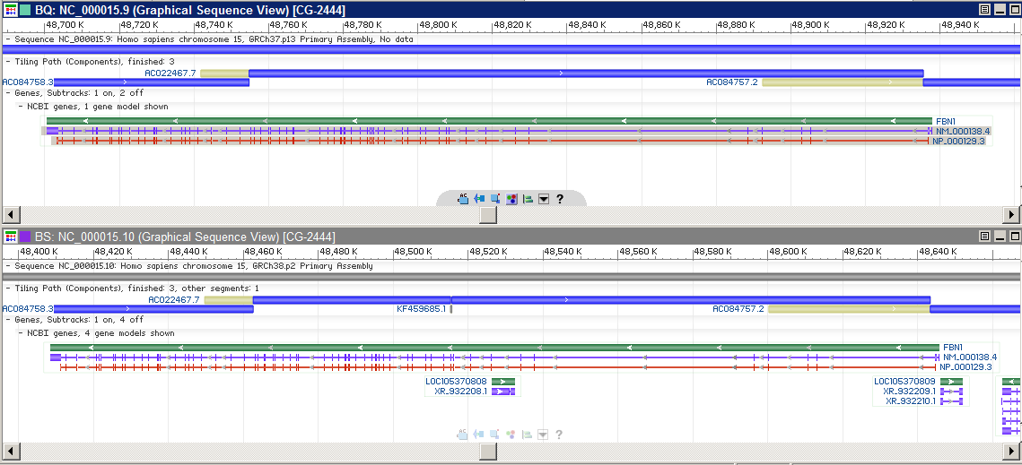

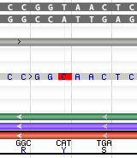

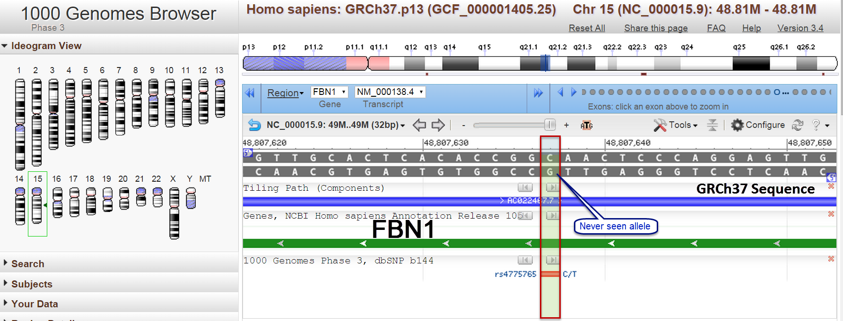
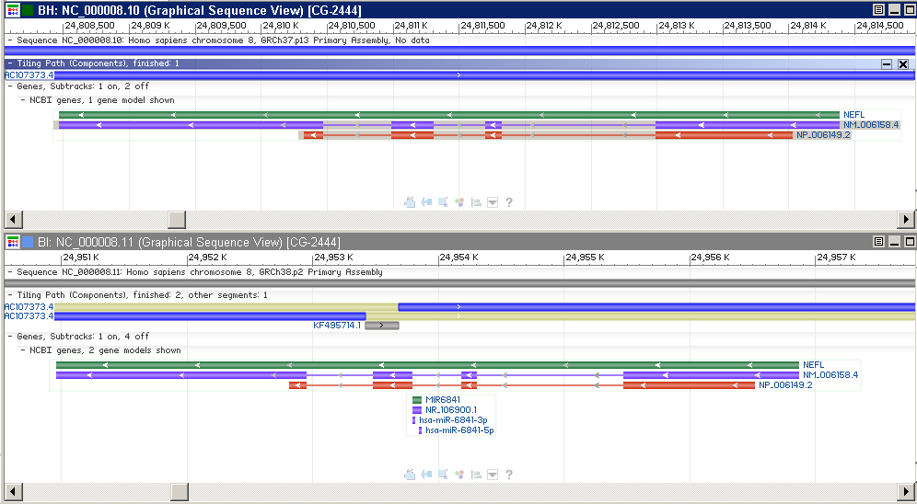
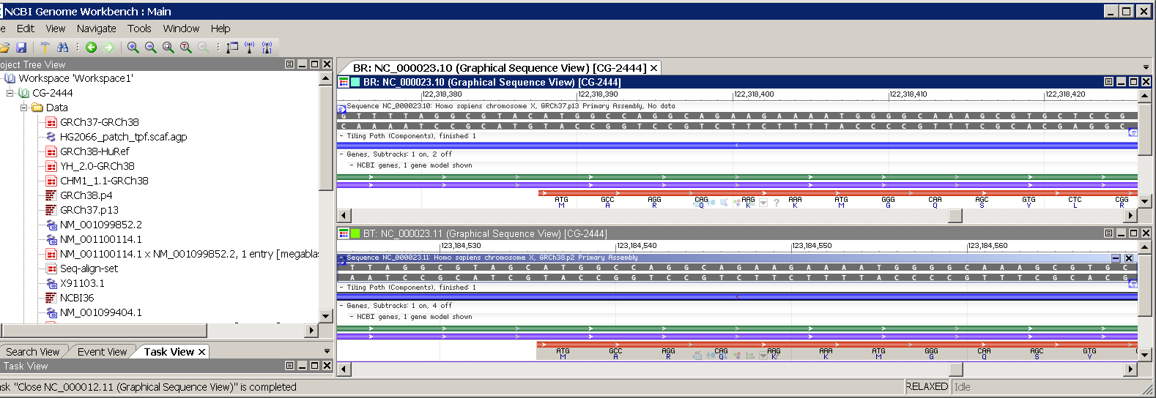
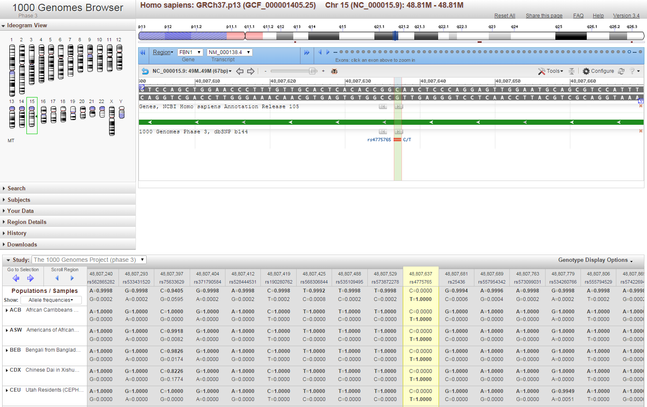
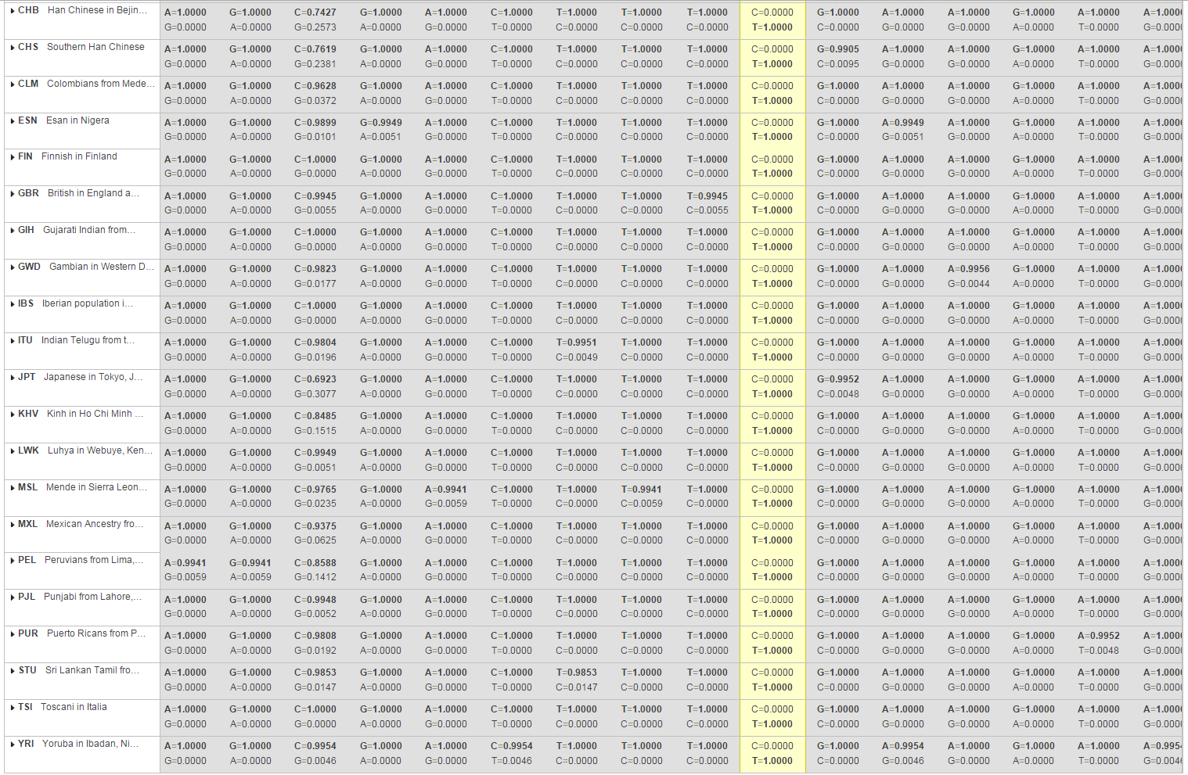
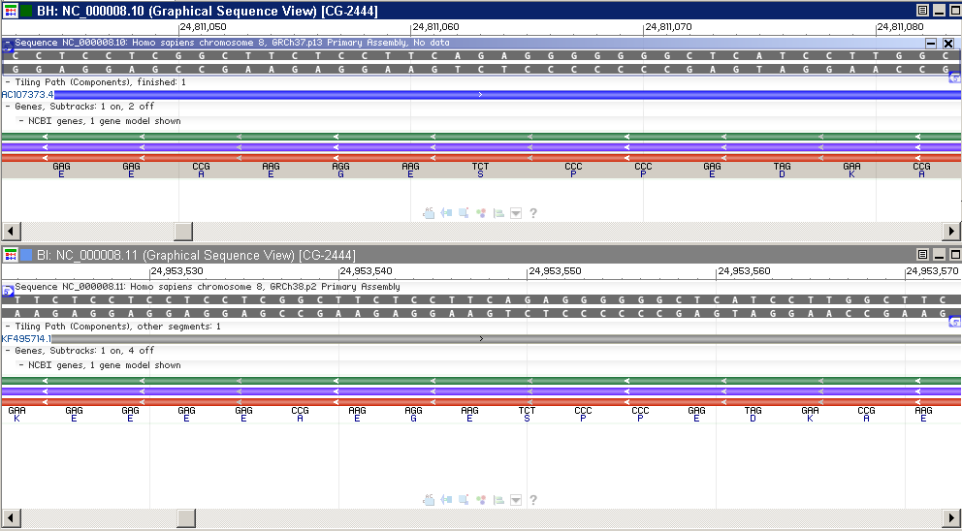



Updates in the human reference genome assembly (GRCh38)
T. Rezaie, V.A. Schneider, T. Graves, P. Flicek, R. Durbin for the Genome Reference Consortium
http://genomereference.org
@GenomeRef
Human Reference Assembly
GRC Public Resources
Types of updates in GRCh38
  Gap closures
  Targeted base and component updates (with clinically related examples shown)
  Tiling path changes
  Modeled centromere sequence replace gaps
  Alternate sequence representations
  for >170 regions
GRCh38 sequence: You can download GRCh38 files including alignments of the alt loci to the primary assembly from the GenBank FTP site:
Graphical representation of GRCh38.p4. Ideograms represent the primary assembly unit. Regions affiliated with Chr. 9 which contain alt loci, fix and novel patches are shown in detail.
ftp://ftp.ncbi.nlm.nih.gov/genbank/genomes/Eukaryotes/vertebrates_mammals/Homo_sapiens/GRCh38/
Find more details at GRC “Human Genome Overview”: http://www.ncbi.nlm.nih.gov/projects/genome/assembly/grc/human/
Assembly Statistics (GRCh38.p4)
Human Genome Assembly Data are available at:
http://www.ncbi.nlm.nih.gov/projects/genome/assembly/grc/human/data/
Improving the Assembly
GRCh38.p4
gap closure
Resolved in GRCh38
Ongoing Curation
Human Genome Issue: The GRC website provides the latest data about assembly problems, ongoing work and other issues related to the human reference genome. Issues are searchable, a brief description of the issue with the current status and graphical mapping of issue to assemblies are available. In example shown above (HG-1392), addition of 2 WGS components in GRCh38.p4 closed the gap existed in GRCh37 which contained 1 exon of INPP5D gene.
Association of mutations in INPP5D reported in defects and cancers of the immune system.
Targeted base update
The GRC welcomes users to report assembly problems
http://www.ncbi.nlm.nih.gov/projects/genome/assembly/grc/ReportAnIssue.shtml
FBN1
GRCh37 Chr. 15
FBN1
GRCh38 Chr. 15
GRCh38
GRCh37
http://www.ncbi.nlm.nih.gov/variation/tools/1000genomes/
Targeted base update
Component version update
NEFL
GRCh37 Chr. 8
GRCh37 Chr. X
Z83848.1
NEFL
GRCh38 Chr. 8
GRIA3
1-bp deletion
GRCh37 Chr. 8
NEFL
GRCh37 Chr. 8
Z83848.3
1-bp insertion
GRCh38 Chr. X
GRIA3
GRCh38 Chr. 8
NEFL
GRCh38 Chr. 8
Reference componet version update: fixed 1bp deletion in Kozak signal of GRIA3 gene caused by a sequencing error. Mutations in GRIA3 have been reported in “mental retardation, X-linked 94”.
Update of a never seen allele improved FBN1 alignment to the Reference. FBN1 mutations are associated with multiple conditions (i.e. Marfan syndrome).
Targeted update to coding sequence: Correcting of 1bp insertion in reference improved representation of NEFL gene. Mutations in NEFL cause Charcot-Marie-Tooth disease types 1F & 2E.

