Slide 1






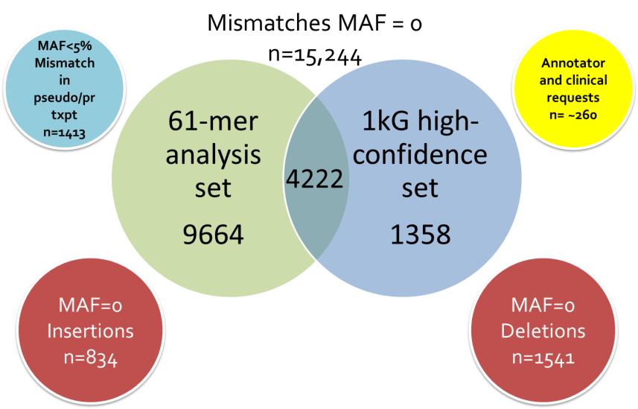
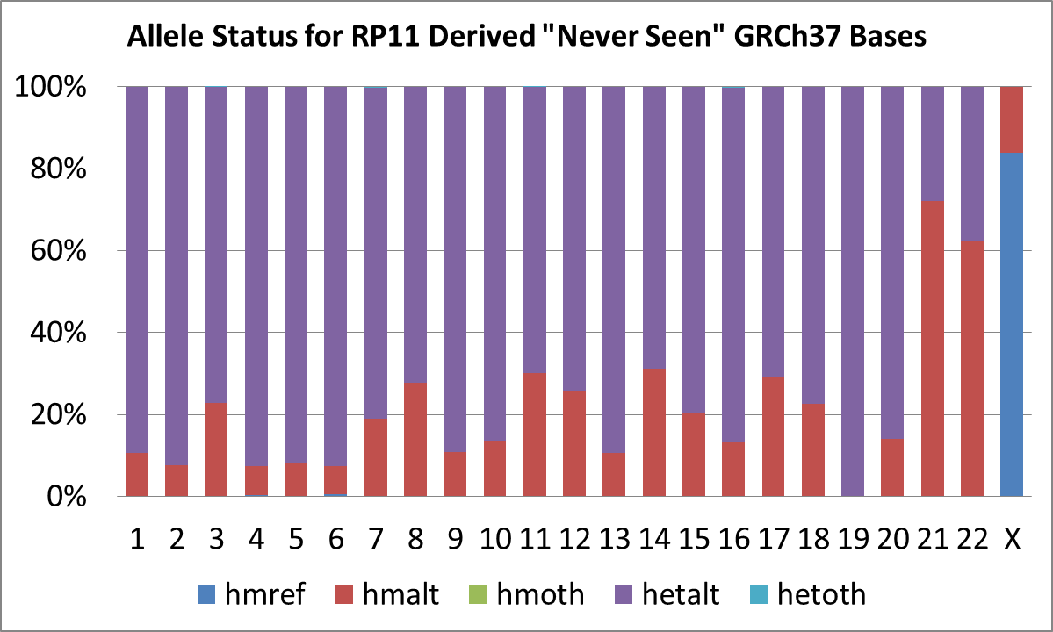
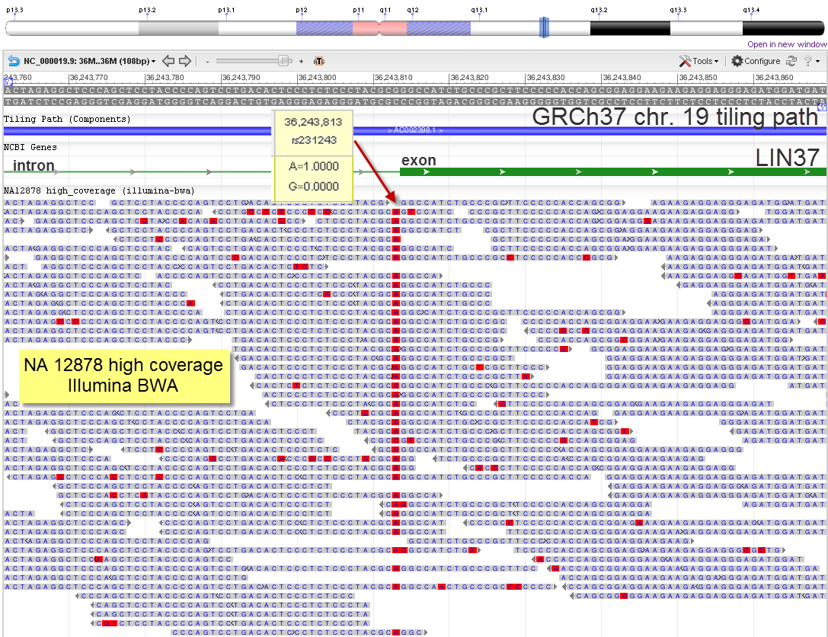
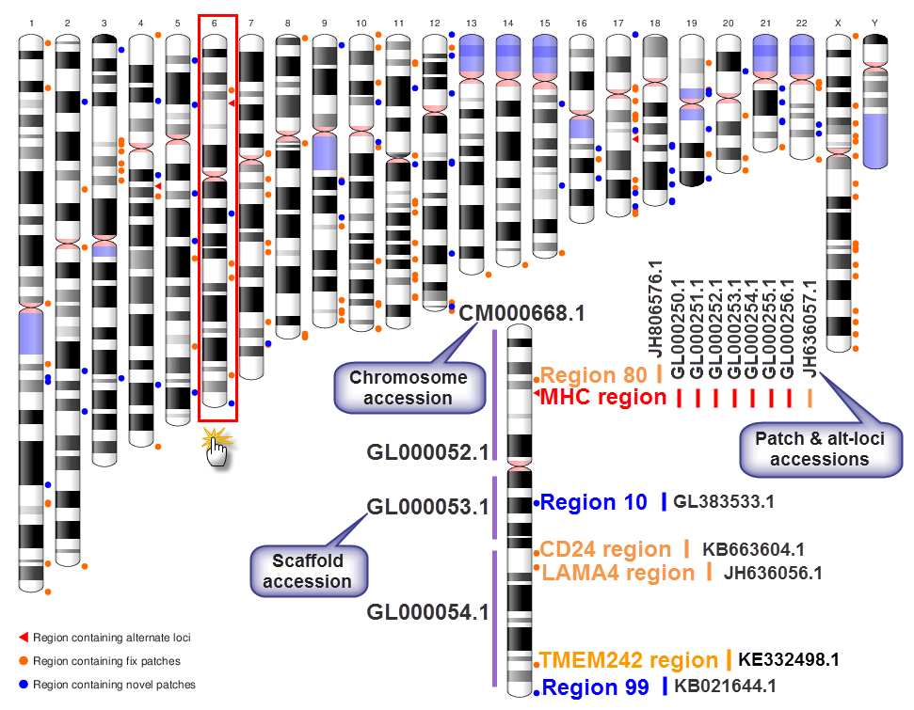
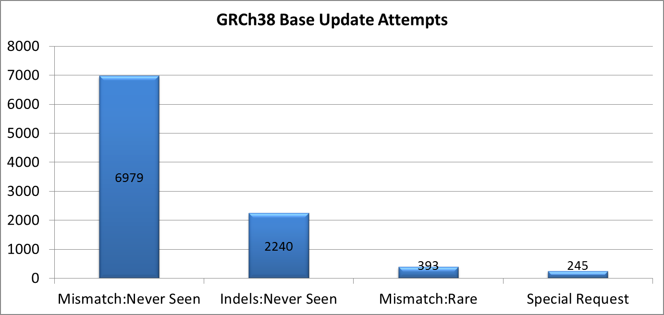
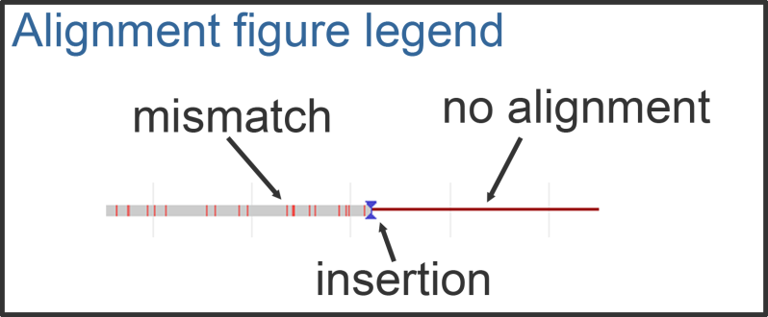
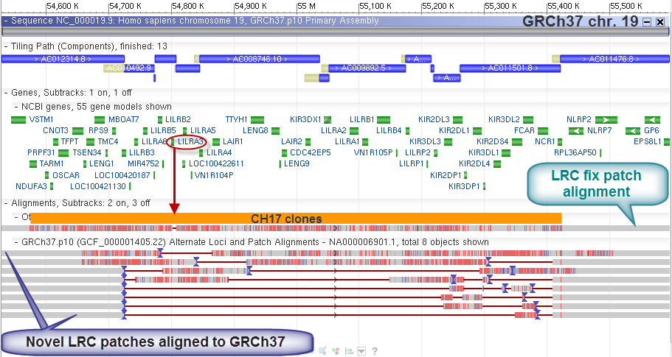
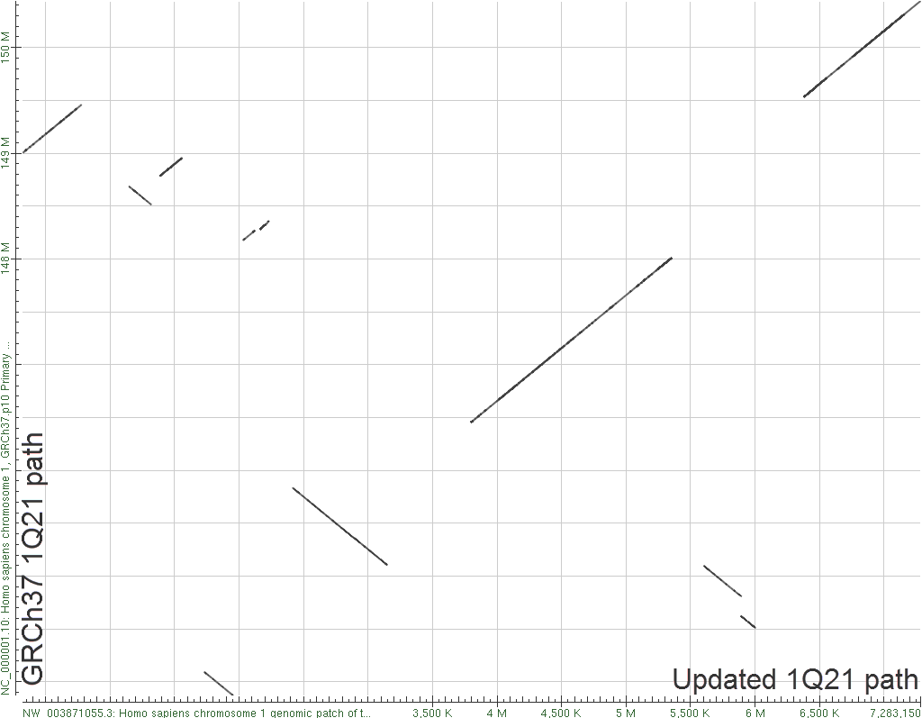
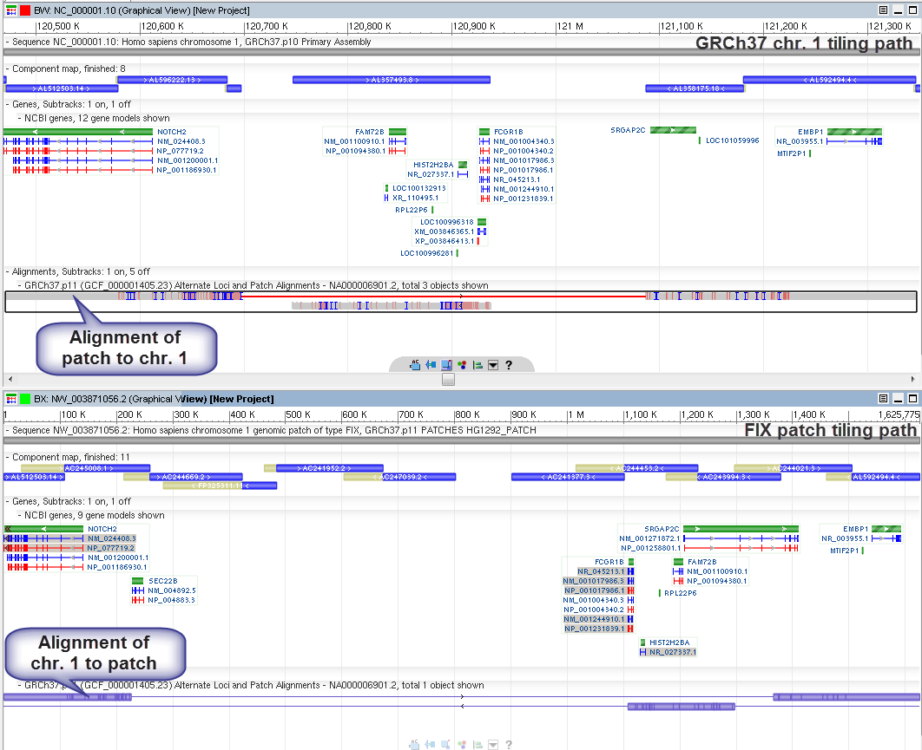
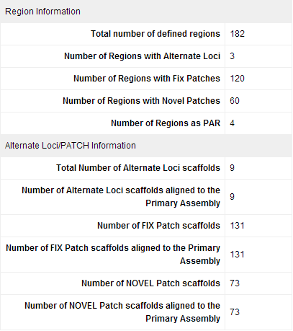
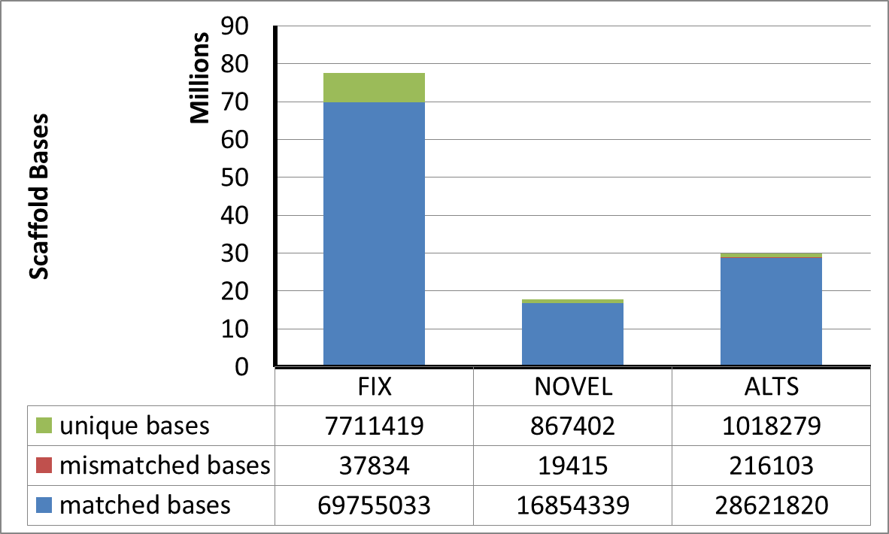
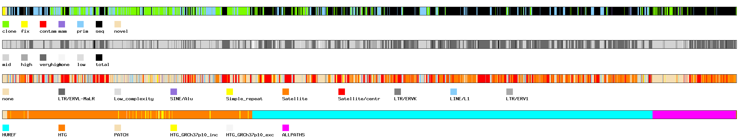
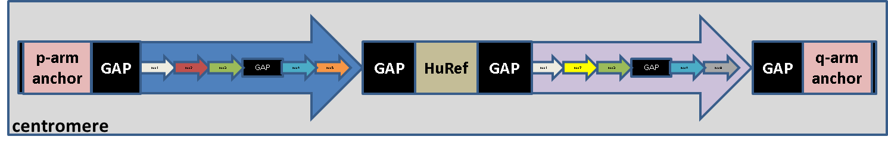
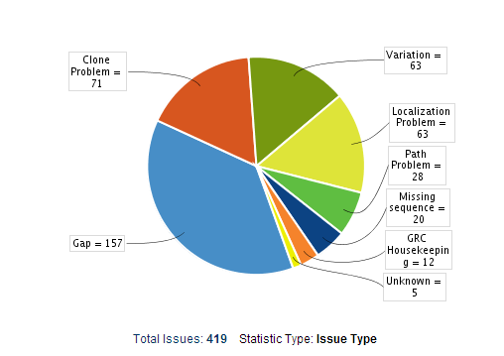
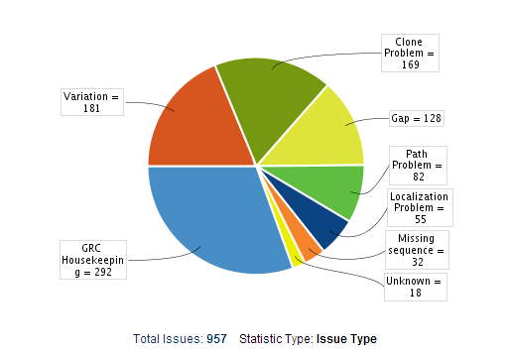
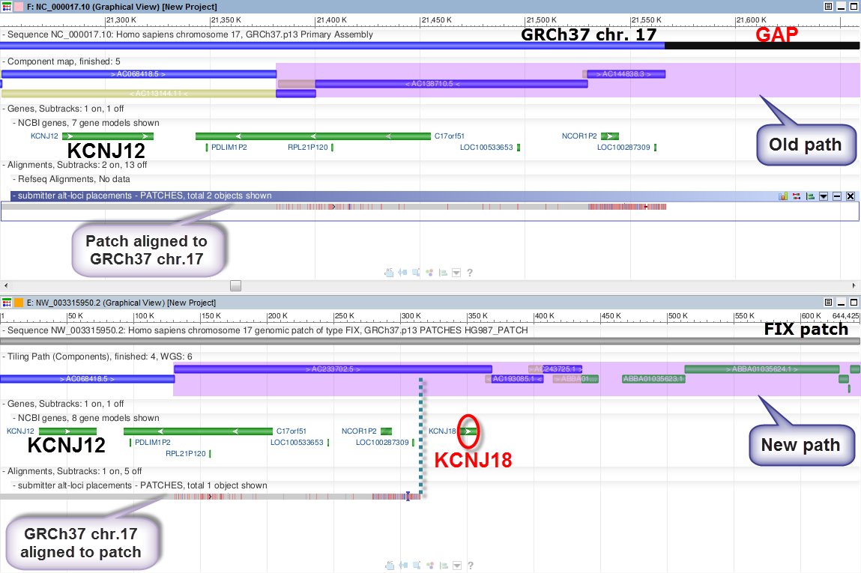
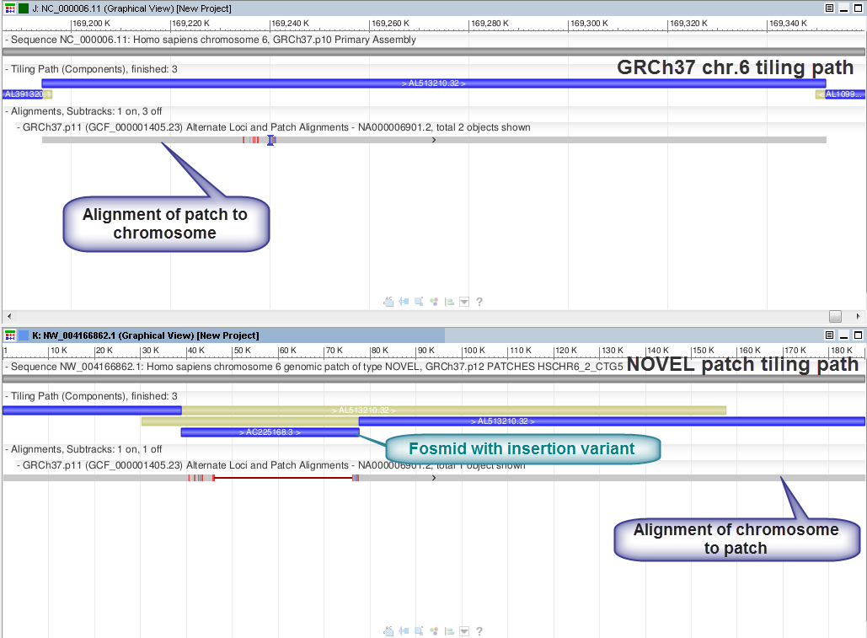
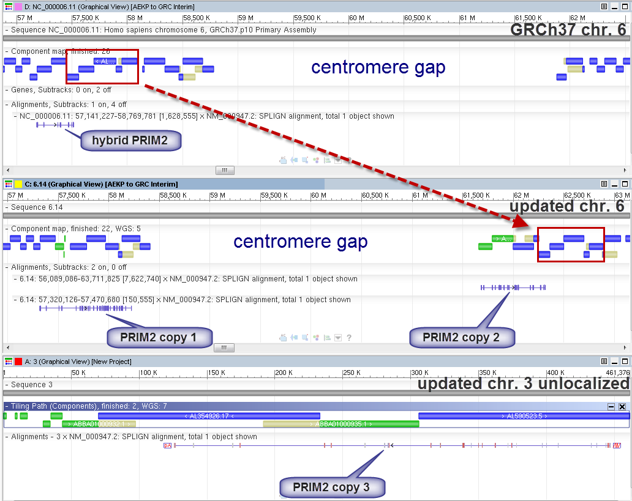
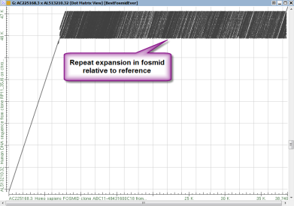
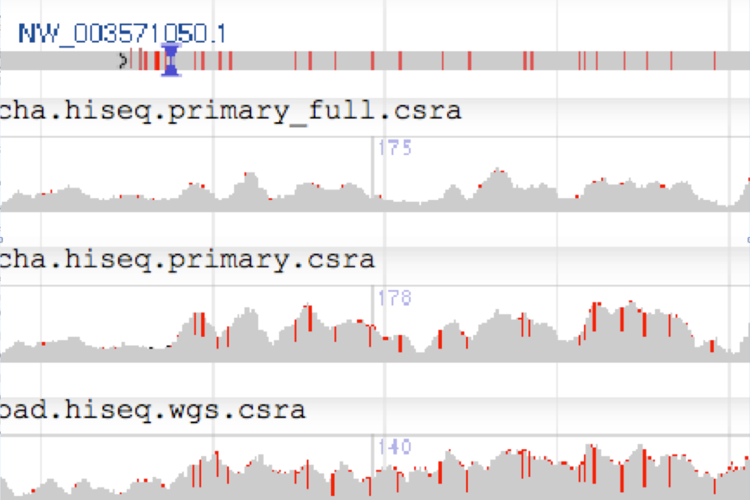
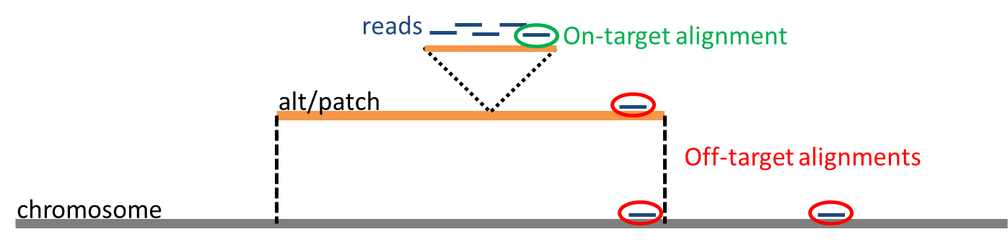
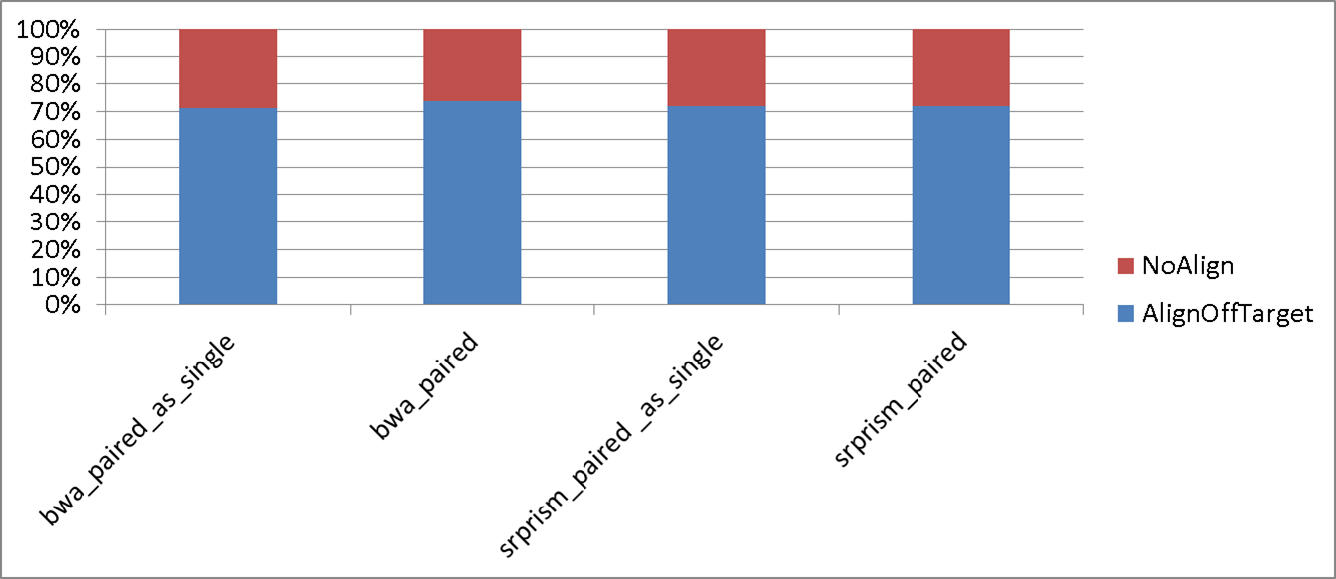
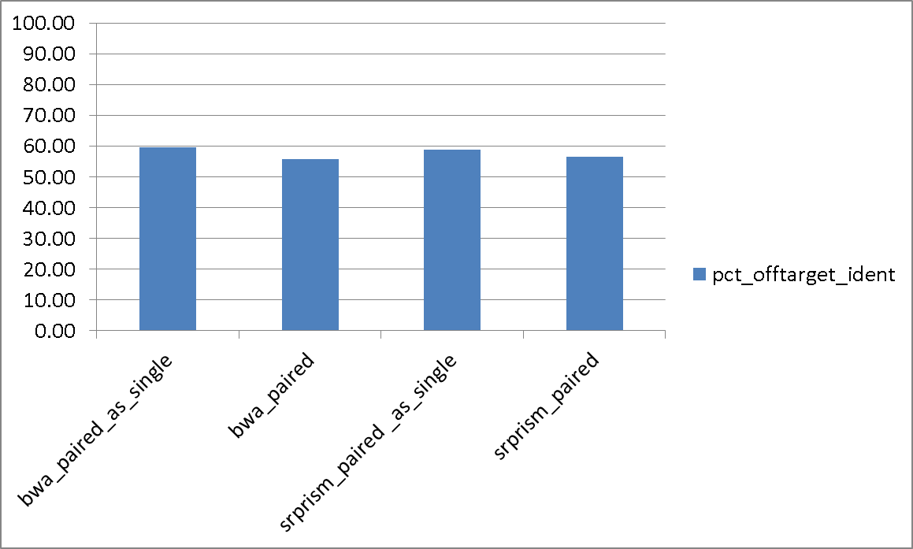
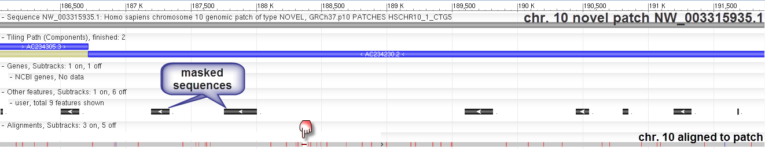
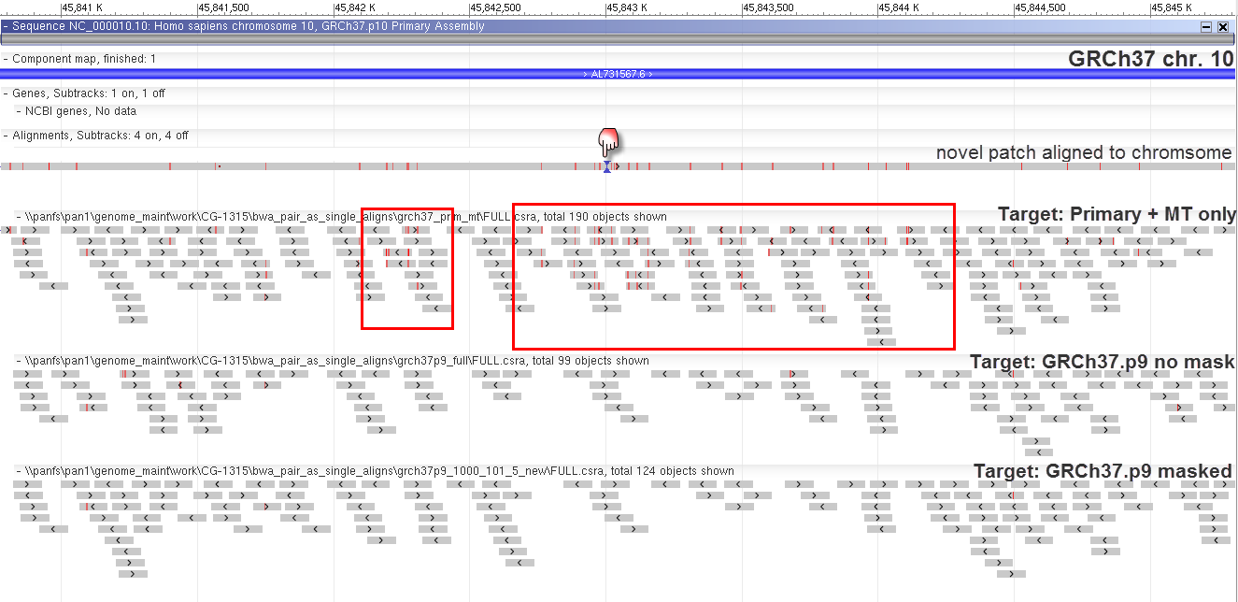
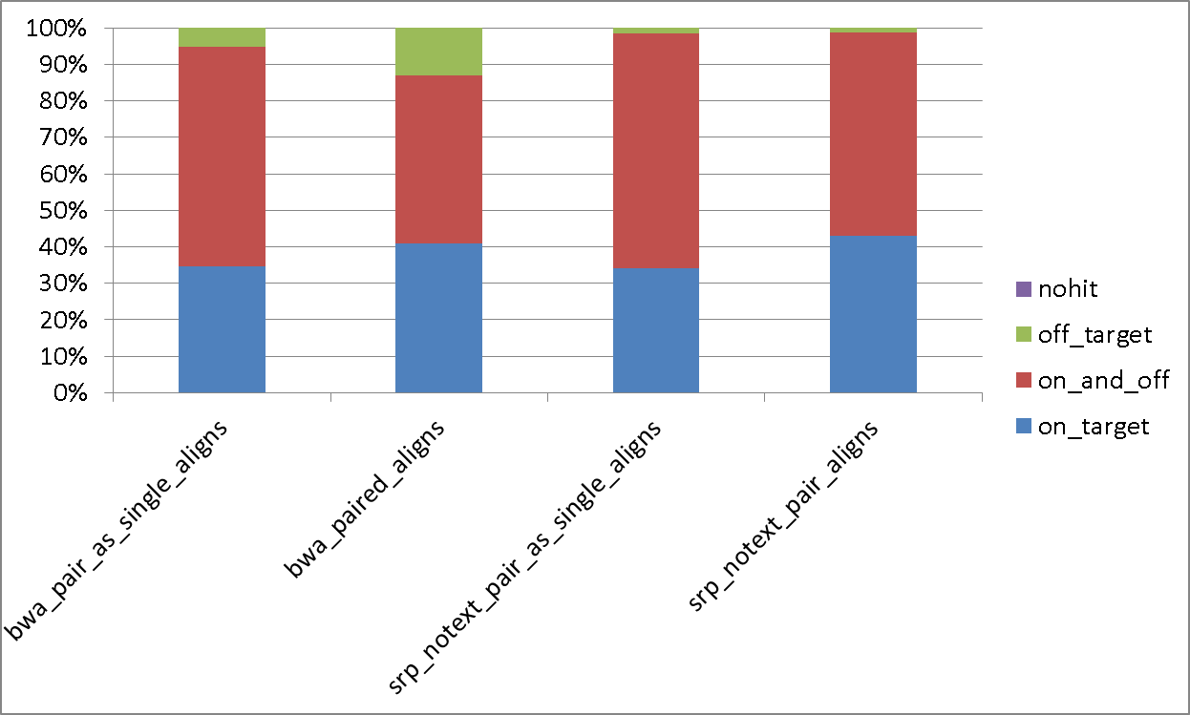
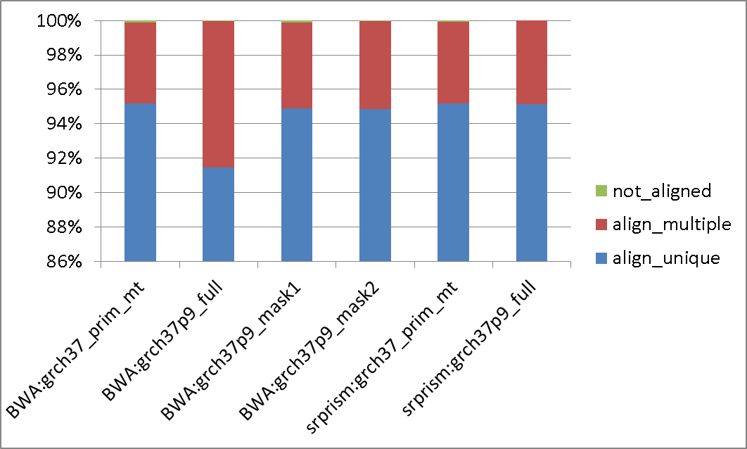



Updating the human reference assembly
V.A. Schneider, P. Flicek, T. Graves, T. Hubbard & D.M. Church for
the Genome Reference Consortium
http://genomereference.org
@GenomeRef
The GRCh38 human reference assembly is currently being processed and will be released this fall. If you have questions about this, let us know at http://genomereference.org.
How the Assembly is Changing
GRCh38: Updating Individual Bases
Reference Assembly Model
A
A
B
C
A. Sources of candidate bases (top). Final distribution of attempted base updates (bottom). B. Analysis of RP11 WGS reads aligned to GRCh37 RP11-derived bases never seen in 1000 Genomes samples. 80% of sites are heterozygous in RP11, not sequencing errors. C. NA12878 read alignments identify an erroneous GRCh37 base in the LIN37 CDS.
GRCh38: Tiling Path Updates
Graphical representation of GRCh37.p13. Ideograms represent the primary assembly unit. Sequences affiliated with chr. 6 are shown in greater detail. Alignments of alt loci and patch scaffolds to the primary assembly provide chromosome context.
GRCh37.p13 Assembly Statistics
Several complex genomic regions have been retiled as a single haplotype. The KIR/LRC region of chr. 19, comprised of mixed haplotypes in GRCh37, has been updated with clones from the CH17 library to represent the A01 haplotype . The LILRA3 gene is absent from this haplotype. There will be 35 alternate representations of this region in GRCh38. The 1Q21 (middle), 1P11 (right) and 1Q32 (not shown) regions, containing SRGAP family members, have also been retiled with the single CH17 haplotype in GRCh38.
178 regions: 3.15% of chromosome sequence
131 FIX patches: Add 6.8 Mb novel sequence
73 NOVEL patches: Add >800 Kb novel sequence
GRCh38: Capturing Missing Sequence
Sequence absent from GRCh37 is captured in various forms. Above: Left: Breakdown of 1000 Genomes decoy sequence by alignment to GenBank, Repeat Masker coverage, Repeat Masker class, and source. Right: In GRCh38, modeled centromere sequences will be included. Below: A. Addition of new sequence at a GRCh37 chr.17 gap partially captures a missing segmental duplication and adds KCNJ18. B. Novel patch adds a sequence variant with a 40kb repeat insertion. C. Retiling of chr. 6 peri-centromeric region and addition of chr. 3 unlocalized sequence corrects a collapsed duplication and captures missing PRIM2 gene copies .
Patch, alternate loci and assembly region data. FIX patches correct assembly errors. NOVEL patches represent sequence variants. Regions are domains where patches and alt loci align.
Unresolved Human Issues
Resolved for GRCh38
Increased Allelic Diversity: A
Means of Improving Alignments
A
B
C
Approach 1: Mask homolo-gous regions of alts/patches
A
B
Experiment: Using simulated 101 bp reads, determine the fate of reads derived from patch/alt regions that don’t align to the chromosome when aligning to a target that only includes chromosome sequences.
(n=122,922)
Reads sourced from alt/patch unique sequence. A. ~75% have an off-target alignment when proper target unavailable (GRCh37 primary only). B. Roughly half of these are due to exact duplication and cannot be resolved without longer reads.
Approach 2: Use an alt & patch aware aligner, such as SRPRISM (Agarwala, in press)
Above left: Simulated reads aligned with BWA to GRCh37 1º & MT only or to GRCh37.p9 without and with masking of highly homologous sequence. Box: improved alignments at an alternate locus insertion. Above right: Chr. 12 novel patch with insertion. NA12878 reads aligned to full assembly with SRPRISM (top), primary only with SRPRISM (middle) and 1000G reference with BWA (bottom).
Left: Reads aligned to full GRCh37.p9 with masks for BWA and no masks for SRPRISM. Mask 1: mask chr for fix patch and alt/patch for alternate loci. Mask2: only mask alts/patches.
Above: Reads aligned to GRCh37.p9, without masking
Conclusion: Both masking and using an alternate locus aware aligner improve sequence alignments

